Slide 1




Welcome and Opening Remarks
Michael Watson
December 5, 2018
www.vita.virginia.gov
1

Slide 2
ISOAG December 5, 2018 Agenda
I. Welcome & Opening Remarks Mike Watson, VITA
II. National Cybersecurity Center for Excellence Tim McBride,NIST
III. Panel Discussion on Ransomware Gregory Bell,DBHDS,
Samuel “Gene” Fishel,OAG
Wes Kleene, VITA
Tim Mcbride,NIST
IV. Tier III Data Center Chris Boswell, VITA
V. Upcoming Events Mike Watson
VI. Partnership Update SAIC

Slide 3
National Cybersecurity Center of Excellence
Increasing the adoption of standards-based
cybersecurity technologies
VITA ISOAG
12/5/2018

Slide 4
Defined

Slide 5

Mission
Accelerate adoption of secure technologies: collaborate with innovators to provide real-world, standards-based cybersecurity capabilities that address business needs
Notes:
Talking points:
We do not create standards
We apply standards to current challenges
We use best practices and commercially available technologies to solve challenges
Vision: A secure cyber infrastructure that inspires technological innovation and fosters economic growth
Goals:
1. Provide practical cybersecurity: Help people secure their data and digital infrastructure by equipping them with practical ways to implement standards-based cybersecurity solutions that are modular, repeatable and scalable
2. Increase rate of adoption: Enable companies to rapidly deploy commercially available cybersecurity technologies by reducing technological, educational and economic barriers to adoption
3. Accelerate innovation: Empower innovators to creatively address businesses’ most pressing cybersecurity challenges in a state-of-the-art, collaborative environment

Slide 6




Foundations
Collaborative Hub
The NCCoE assembles experts from businesses, academia, and other government agencies to work on critical national problems in cybersecurity. This collaboration is essential to exploring the widest range of concepts.
As a part of the NIST cybersecurity portfolio, the NCCoE has access to a wealth of prodigious expertise, resources, relationships, and experience.

Slide 7

NIST Information Technology Laboratory
Cultivating Trust in IT and Metrology through measurements, standards and tests
Fundamental research in mathematics, statistics, and IT
Standards development and technology transfer
Applied IT research and development
ITL Programs
Advanced Networking
Applied and Computational Mathematics
Cybersecurity
Information Access
Software and Systems
Statistics
Collaborations with
Industry
Federal/State/Local Governments
Academia

Slide 8

NIST Computer Security Division (CSD)
CSD conducts research, development, and outreach to provide standards and guidelines, mechanisms, tools, metrics, and practices to protect U.S. information and information systems
CSD Programs
Cryptographic Technology
Secure Systems and Applications
Security Components and Mechanisms
Security Engineering and Risk Management
Security Testing, Validation, and Measurement

Slide 9

NIST Applied Cybersecurity Division (ACD)
Implements practical cybersecurity and privacy through outreach and effective application of standards and best practices necessary for the U.S. to adopt cybersecurity capabilities
ACD Programs
Cybersecurity and Privacy Applications
Cybersecurity Framework
National Cybersecurity Center of Excellence
National Initiative for Cybersecurity Education
Privacy Engineering and Risk Management
Trusted Identities Group

Slide 10
Engagement & Business Model
Define
Assemble
Build
Advocate
Outcome:
Build a practical, usable, repeatable implementation
to address the cybersecurity challenge
Outcome:
Define a scope of work with industry to solve a pressing cybersecurity challenge
Outcome:
Assemble teams of industry orgs, govt agencies, and academic institutions to address all aspects of the cybersecurity challenge
Outcome:
Advocate adoption of the example implementation using the practice guide

Slide 11
Engagement & Business Model
Define
Outcome:
Define a scope of work with industry to solve a pressing cybersecurity challenge
Conduct market research
  Explore and identify pressing cybersecurity challenges
  Understand business needs and drivers
Assess and document project scope and impact
  Meet with industry and industry organizations to further define cybersecurity challenges from technical and business perspectives
Draft project description
  Define and refine specific challenge to address
  Publish a draft project description with high-level architecture for public comment

Slide 12
Engagement & Business Model
Outcome:
Assemble teams of industry organizations, government agencies, and academic institutions to address all aspects of the cybersecurity challenge
Assemble
Outcome
Assemble Community of Interest (COI)
  Invite corporations and individuals with relevant knowledge, experience, and interest in shaping the project
  Collaborate with COI to refine the final project description
Seek innovative technology vendors
    Identify capabilities needed for the reference design
    Publish a Federal Register Notice (FRN) inviting technology vendors to participate in the project build team
Assemble project build team
  Technology vendors sign a Cooperative Research and Development Agreement (CRADA) to join build team and become technology collaborators
  Technology collaborators contribute hardware, software, and expertise

Slide 13
Engagement & Business Model
Build
Outcome:
Build a practical, usable, repeatable example implementation to address the cybersecurity challenge
Refine reference design
  Refine reference design based on the commercially available vendor technologies
  Vet reference design with COI
Build example implementation
  Integrate technologies into example implementation
  An example implementation is a modular, easily adaptable set of instructions
Engage industry and refine example implementation
  Demo example implementation for comment
  Conduct outreach and engagement to industry and stakeholders

Slide 14
Engagement & Business Model
Outcome:
Advocate adoption of the example implementation using the easy-to-understand practice guide
Advocate
Publish SP 1800
  SP 1800 Practice Guides are free publications that encourage and instruct businesses to adapt the example implementation to their own environment
  Available for download at https://nccoe.nist.gov, practice guides include three volumes of varying technical complexity
Engage industry and seek feedback
  Each draft practice guide has a public comment period
  Comments are reviewed and incorporated into final SP 1800 Practice Guide publication
Encourage adoption of secure technologies
  Through outreach and engagement with industry, demonstrate how the example implementation can help solve the cybersecurity challenge

Slide 15
Body of Work

Slide 16
NCCoE Tenets
Standards-based
Apply relevant industry standards to each security implementation; demonstrate example solutions for new standards
Modular
Develop components that can be easily substituted with alternates that offer equivalent input-output specifications
Repeatable
Provide a detailed practice guide including a reference design, list of components, configuration files, relevant code, diagrams, tutorials, and instructions to enable system admins to recreate the example solution and achieve the same results
Commercially available
Work with the technology community to identify commercially available products that can be brought together in example solutions to address challenges identified by industry
Usable
Design blueprints that end users can easily and cost-effectively adopt and integrate into their businesses without disrupting day-to-day operations
Open and transparent
Use open and transparent processes to complete work; seek and incorporate public comments on NCCoE publications

Slide 17
Portfolio
Attribute Based Access Control
(SP 1800-3)
Consumer/Retail: Multifactor Authentication for e-Commerce
(SP 1800-17)
Data Integrity: Identifying and Protecting
Data Integrity: Detecting and Responding
Data Integrity: Recovering
(SP 1800-11)
Derived PIV Credentials
(SP 1800-12)
DNS-Based Email Security
(SP 1800-6)
Energy: Asset Management
Energy: Identity and Access Management (SP 1800-2)
Energy: Situational Awareness
(SP 1800-7)
Financial Services: Access Rights Management (SP 1800-9)
Financial Services: IT Asset Management (SP 1800-5)
Financial Services: Privileged Account Management (SP 1800-18)
Healthcare: Securing Electronic Health Records on Mobile Devices (SP 1800-1)
Healthcare: Securing Picture Archiving and Communication Systems
Healthcare: Securing Wireless Infusion Pumps
(SP 1800-8)
Hospitality: Securing Property Management Systems
Mitigating IoT-Based DDoS
Manufacturing: Capabilities Assessment for Securing Manufacturing Industrial Control Systems
Mobile Device Security: Cloud and Hybrid Builds (SP 1800-4)
Mobile Device Security: Enterprise Builds
Mobile Threat Catalogue
Privacy-Enhanced Identity Federation
Public Safety/First Responder: Mobile Application SSO (SP 1800-13)
Secure Inter-Domain Routing
(SP 1800-14)
TLS Server Certificate Mgmt
Transportation: Maritime: Oil & Natural Gas
Trusted Cloud

Slide 18
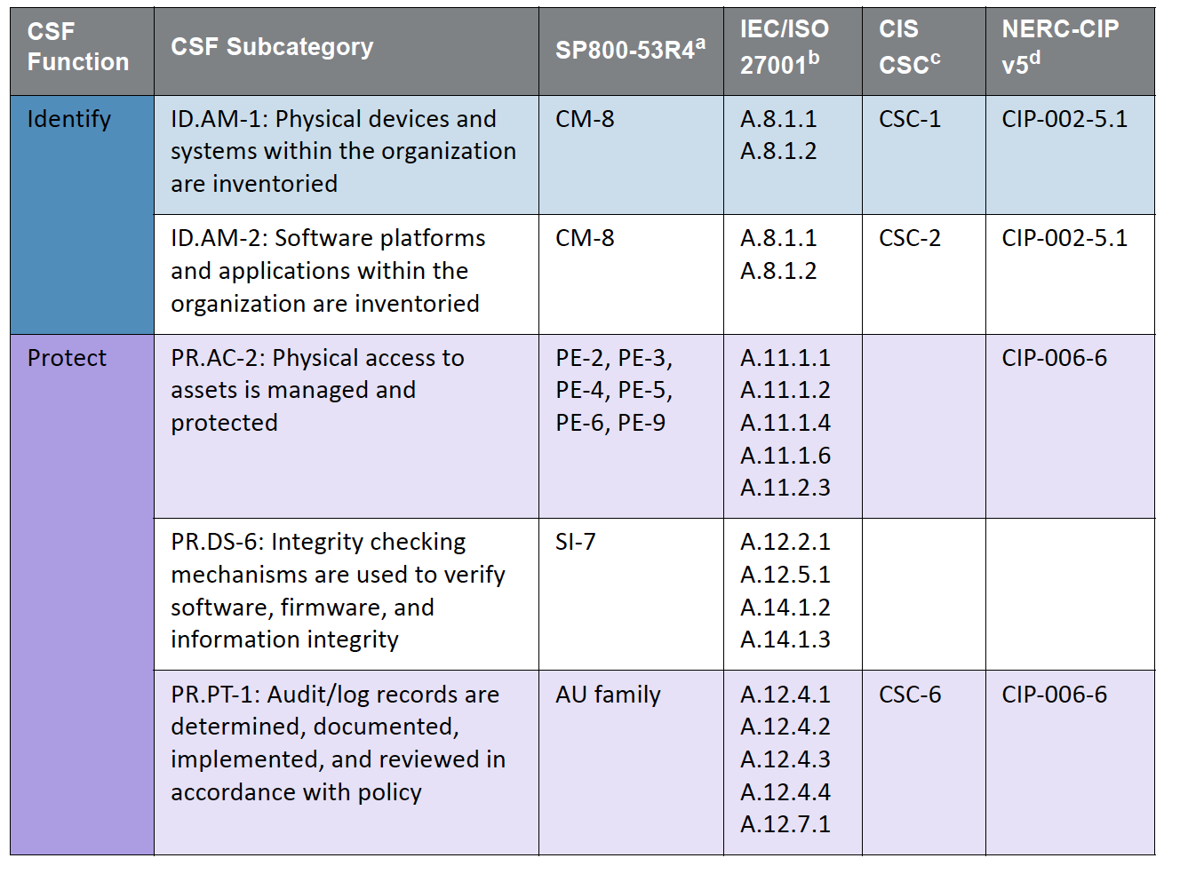
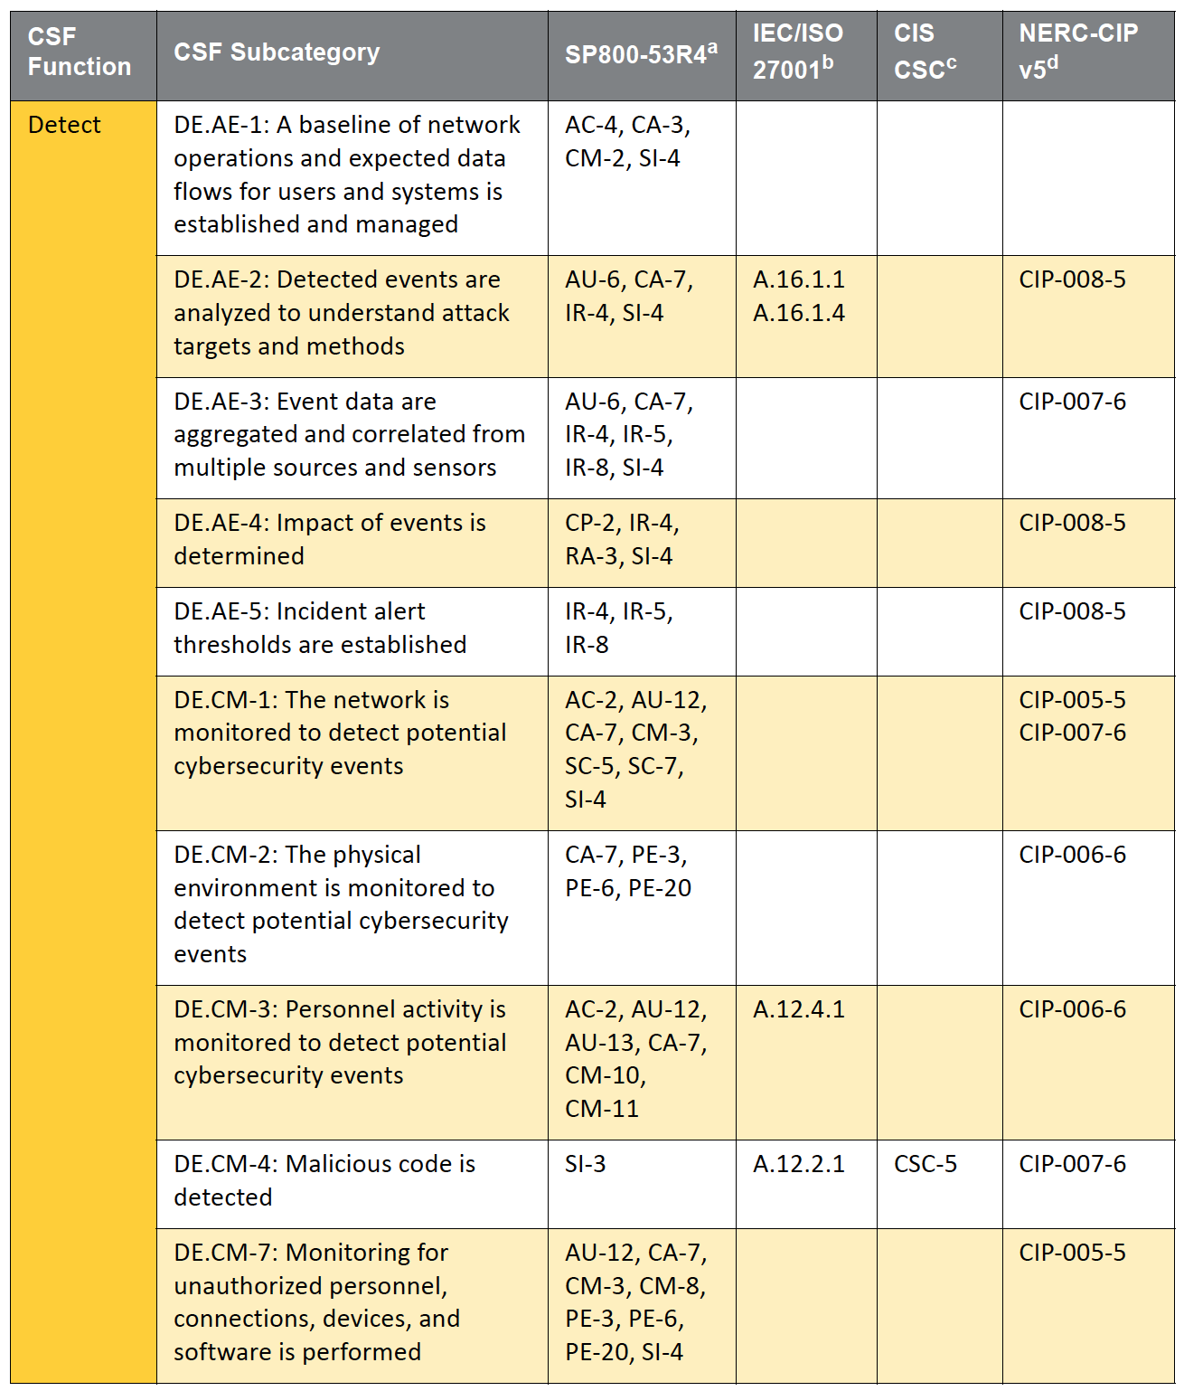
SP 1800 Series: Cybersecurity Practice Guides
Volume A: Executive Summary
High-level overview of the project, including summaries of the challenge, solution, and benefits
Volume B: Approach, Architecture, and Security Characteristics
Deep dive into challenge and solution, including approach, architecture, and security mapping to the Cybersecurity Framework and other relevant standards
Volume C: How-To Guide
Detailed instructions on how to implement the solution, including components, installation, configuration, operation, and maintenance

Slide 19

Cross-Sector Projects
Attribute Based Access Control (SP 1800-3)
Data Integrity (SP 1800-11)
Derived PIV Credentials (SP 1800-12)
DNS-Based Secured Email (SP 1800-6)
Mitigating IoT-Based DDoS
Mobile Device Security (SP 1800-4)
Privacy-Enhanced Identity Federation
Secure Inter-Domain Routing (SP 1800-14)
TLS Server Certificate Management
Trusted Geolocation in the Cloud (NISTIR 7904)
Notes:
Formally called Building Blocks

Slide 20

Sector-Based Projects
Commerce/Retail
Energy
Financial Services
Healthcare
Hospitality
Manufacturing
Public Safety/First Responder
Transportation
Notes:
Formerly called Use Cases

Slide 21
Collaborate with Us!

Slide 22
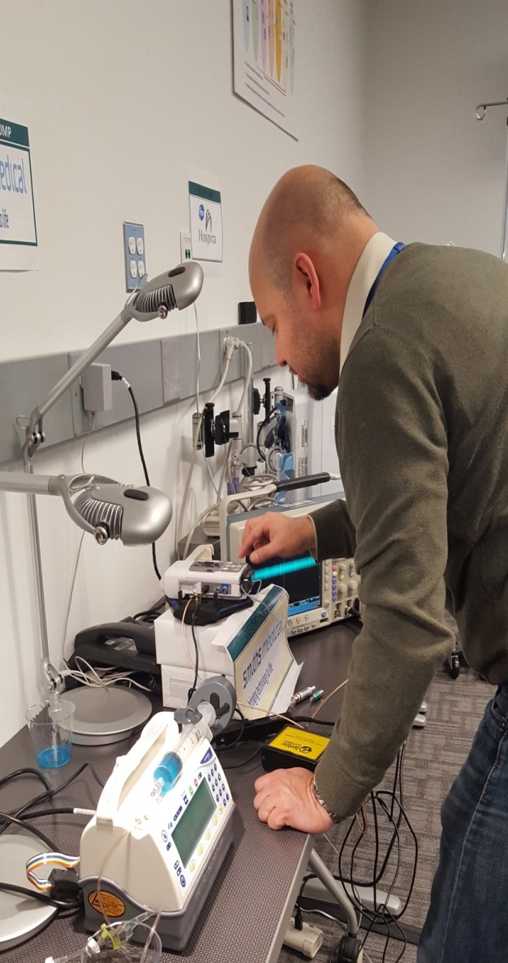
Ways to Collaborate
Sign-up for email updates: https://public.govdelivery.com/accounts/USNIST/subscriber/new
Submit a project idea: https://nccoe.nist.gov/projects
Attend an event: https://nccoe.nist.gov/events
Submit comments on drafts:
https://nccoe.nist.gov/projects
Join a Community of Interest:
https://nccoe.nist.gov/about_the_center/coi
Respond to an FRN: https://nccoe.nist.gov/projects
Share adoption stories: nccoe@nist.gov
Notes:
Talking Points:
Each way to collaborate increases in commitment level as you go down the list
Email updates: subscribe to all NCCoE updates or by project—we will email you with project updates, additional collaboration opportunities, and upcoming events
Have an idea for a new NCCoE project? Submit it online.
Attend an event: local, national, international and online events—this page is up to date
This page will show you what publications are currently accepting public comments—comments can be entered on the online form or emailed to nccoe@nist.gov
Join a COI—many area of interest, most meet monthly on teleconference to discuss current projects and new ideas
Tech vendors—submit an LOI in response to an FRN to participate in a project build
If you used part or all of one of our practice guides at your organization, we would love to hear about—what worked, what did you tweak, etc.
Benefits of Collaboration
Insight into industry issues: network with industry experts and academics
Wide recognition of collaboration: logo on website (.gov) and in publications (SP 1800)
Help shape and define NCCoE projects
Receive guidance for addressing cybersecurity challenges
Joint thought leadership opportunities: blog posts, webinars, speaking engagements, etc.
The benefits noted above are tied to different types and parts of any collaboration effort
NCEP partners receive some of the benefits immediately after signing MOU (logo on website)
Technology vendor benefits kick in as the project progresses (logo would be placed onto the project page once all the vendors have signed CRADAs; joint speaking engagements once the project has progressed into a lab build phase, etc.).
Technology vendors:
sign a Cooperative Research and Development Agreement (CRADA) that outlines specific resources (products, services, staff, training, etc.) and allows a vendor to be part of the solution development for a project
provide input on capabilities for a reference architecture and resources to support a lab implementation of the solution
all documented in the NIST SP 1800 series—vendor has opportunity to provide feedback on and/or contribute to the development of that document
COIs:
a group of professionals and advisors that share business insights, technical expertise, challenges, and perspectives to guide NCCoE projects—grouped by sector or project topic (e.g. retail, healthcare, mobile device security, etc.)
often include senior-level professionals and researchers from across the private, public, and academic sectors
members typically meet monthly by teleconference
benefits are immediate: network, help shape/define projects, guidance for challenges

Slide 23

































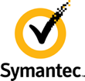



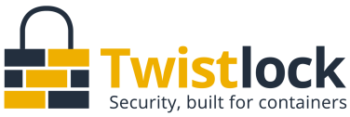

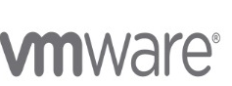
National Cybersecurity Excellence Partnership
Notes:
Talking Points:
NCEPs are critical technology partners that sign a Memorandum of Understanding (MOU) with NIST that signifies a broad partnership:
speak freely about work that we are doing—more strategic discussions
explore early-stage research areas/topics
learn about current products & services as well as potential areas of interest on vender roadmap

Slide 24
National Cybersecurity Excellence Partnership
A formal initiative between U.S. companies and the NCCoE
NCEP Partners:
Provide broad input on NCCoE project development
Provide hardware, software, and/or expertise to advance the adoption of secure technologies
Provide feedback and guidance on NIST Special Publications (1800 series)
Gain insight on pressing cybersecurity challenges to improve technology
Collaborate with industry peers in a safe environment to investigate challenges to improve technology
Improve security of nation by demonstrating commitment to stronger, standards-based cybersecurity through public-private collaboration
Receive recognition for contributions through combined outreach efforts
Option to designate guest researchers to work at the NCCoE in person or remotely

Slide 25










Academic Affiliates Council
Notes:
The AACs are involved to facilitate the national vision and agenda of the NCCoE
The role of USM and the AACs is to:
Work collaboratively with NCCoE to establish and implement a research strategy that addresses future cybersecurity problems and establishes forward looking solutions;
Provide applied and traditional research and development (R&D) and resources (e.g. faculty, students, labs) to support the practical and innovative objectives of the NCCoE, and to accelerate the commercialization and adoption of cybersecurity technologies;
Provide critical infrastructure and other industry sector expertise so that cyber security solutions are tailored to address sector specific issues; and
Engage critical infrastructure and other industry sector partners through existing relationships, by establishing new communities of interest, and by surveying the state of the art/practice in support of the NCCoE mission.

Slide 26













University System of Maryland
Notes:
USM is an integrated partner with MITRE supporting the NCCoE and the National Cybersecurity FFRDC (NCF)
Provides Direct Support to NCCoE Projects:
University of Maryland College Park's Microgrid was leveraged for the Energy Situational Awareness Use Case
Intern Support

Slide 27
Questions?

Slide 28


Tier III Data Center Compliance
Christopher Boswell
IT Security Auditor, VITA IT Security Audit Services
December 5, 2018
www.vita.virginia.gov
28

Slide 29

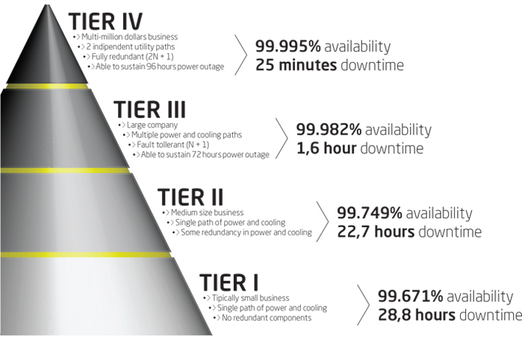



The Tiers (or tears to be compliant with Tier 3)

Slide 30
Tier III Data Center Requirement
(Compliance Date: December 31, 2018)
SEC501 - PE-1-COV:
“All data centers must meet the requirements of a Tier III data center as defined by the Uptime Institute.”
Does VITA meet the topology requirements and operational sustainability behaviors of a Tier 3 Data Center…? Hmmm…

Slide 31


About Uptime Institute, LLC… ($4,985 for accredited training)
A global standard for the proper design, build, and operation of data centers…
Design Documents
Constructed Facility
Operational Sustainability
Prefabricated and Modular

Slide 32
Topology – 14 Requirements
5
Operational sustainability is the focus for this presentation…
Concurrently Maintainable Site Infrastructure
3
Engine-Generator Systems
3
Ambient Temperature Design Points
1
Communications
These categories are related to design details…
1
Makeup Water
1
Utility Services

Slide 33
Topology – Site Infrastructure
Fundamental Requirements
Redundant capacity components
Multiple distribution paths (e.g., electrical, mechanical)
Performance Confirmation
n+1 (will discuss later)
Sufficient capacity
Dual-powered
12-hours on-site fuel
Operational Impacts
Susceptible to disruption from unplanned activities
Unplanned outage of capacity system/component cripples critical environment
Safely work on active equipment by using redundant components
Risk of disruption elevated during maintenance activities
Notes:
Ranked from most to least critical.

Slide 34
Operational Sustainability – 88 Behaviors
Staffing & Organization
12
The behavior must be (1) proactive, (2) practiced, and (3) informed to be compliant.
Maintenance
22
Training
5
Planning, Coordination, & Management
14
Operating Conditions
3
Pre-Operational
5
Building Features
10
These categories are related to operations details…
Infrastructure
10
Natural Disaster
4
Man-Made Disaster
3

Slide 35
Evaluating Behavior Effectiveness
Proactive
Practiced
Informed
Is there a continuous improvement component present to ensure the processes and procedures are always being improved and updated?
Well-documented processes.
Are processes and procedures always followed?
Tasks are accomplished the same way.
Is the knowledge to achieve a behavior held by the individual(s)?
Procedures are available, stored in a known location, and access is granted.

Slide 36
Operational Sustainability – Key Behaviors
Management
& Operations
Qualified employees
Preventive Maintenance (PM)
Building Characteristics
Commissioning Program
Purpose-built
Housekeeping policies
Maintenance Management System (MMS)
Service Level Agreements (SLAs)
Comprehensive Training Program
Adequate space
Controlled access areas
Mechanical support system
And… Site Location!
You probably don’t have to assess the risk of seismic activity, active volcanoes, or your proximity to a fireworks factory, for example; however, flooding, hurricanes, tornadoes, or other man-made disasters are considerations!

Slide 37
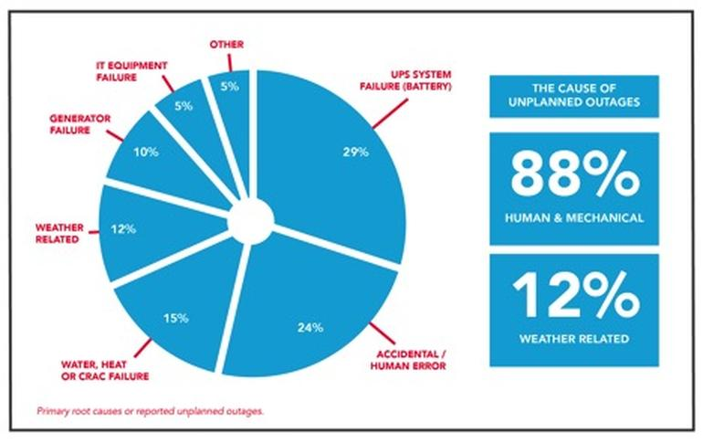
The Cause of Unplanned Outages

Slide 38
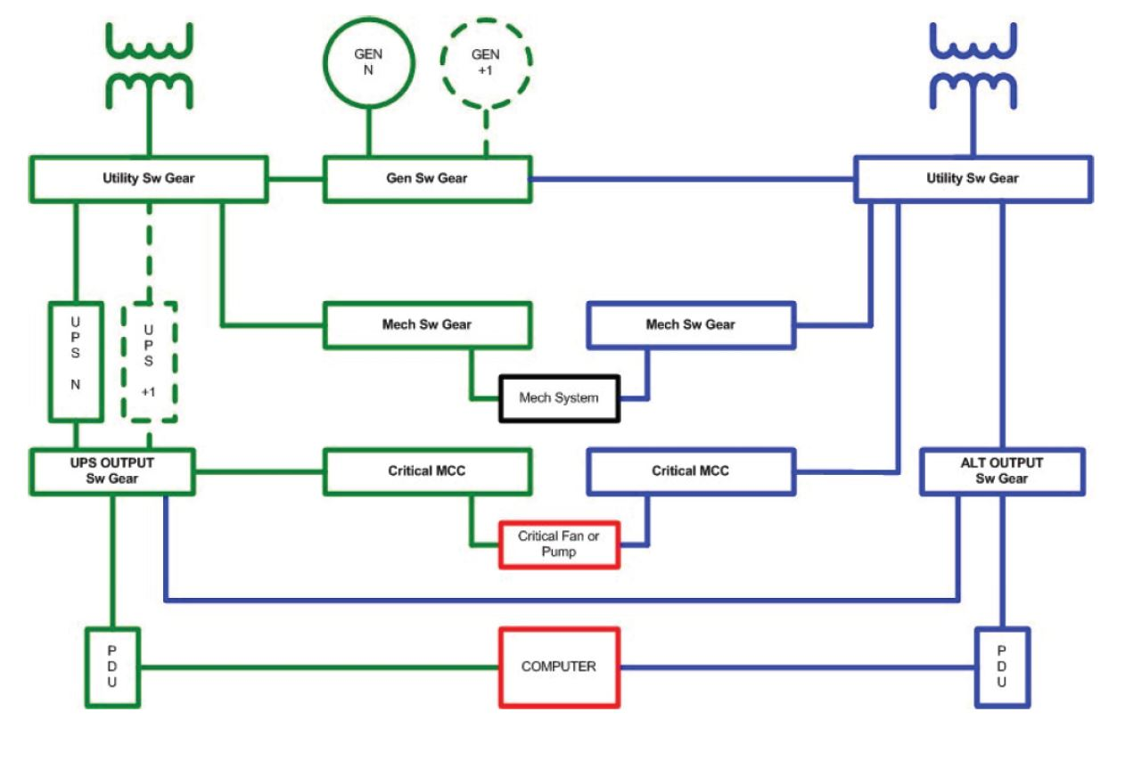
Tier III Design Diagram
The overarching n+1 performance objective…
You can remove each and every capacity component (e.g., UPS, auxiliary generator, CRAH/CRAC) and element in a distribution path (e.g., power, water, natural gas, district cooling) without impacting any of the critical environment.

Slide 39
Security Exception Planning (oh the possibilities…)
24 x 7 staff presence: minimum of 1 FTE
Documented formal classroom, operational demonstrations, and/or shift drills covering: policies, processes, procedures for the operation & maintenance of data center systems, site configuration procedures, standard operating procedures, emergency operating procedures, maintenance management system procedures.
Reference documents located in a centralized location (library) available to site operational personnel.
Process for forecasting future space, power, and cooling growth requirements on a periodic basis (e.g., 1/6/12/24/36 month).
Tracking mechanism for current space, power, and cooling capacity and utilization reviewed periodically.
Stand-alone building physically separated from other corporate facilities on the site.
Engineering trade (e.g., electrical, mechanical, controls, building management system [BMS], etc.) coverage split by shift based on operations and maintenance requirements.
Detailed procedures for switching between redundant equipment –available and in use.
Preventive maintenance accomplishment rate of 100%.
Maintains list of critical spares and reorder points
We performed a security assessment as an audit objective for an undisclosed agency in the Commonwealth that has an on premise data center. They met a lot of the behaviors (and have strong control over their data center). That being said, to the left is a list of behaviors you might want to start adding to your list of items contained in a security exception…

Slide 40
Non-Compliance Trends
The tier topology rating for an entire site is constrained by the rating of the weakest subsystem that will impact site operation. For example…
A site may have a fault tolerant electrical system patterned to a Tier IV solution, but use a Tier II mechanical system that cannot be maintained without interrupting computer room operations - which would result in an overall Tier II site rating.

Slide 41

Solution

Slide 42
Tier III Framework (a free deliverable)
www.linkedin.com/in/cboswell0
To request an Excel file of the framework we created to assess a Tier 3 data center:
Mark McCreary | mark.mccreary@vita.virginia.gov
Timothy Watson | timothy.watson@vita.virginia.gov
Matt Steinbach | matthew.steinbach@vita.virginia.gov
Nat Chusing | natthachai.chusing@vita.virginia.gov

Slide 43

Questions
www.linkedin.com/in/cboswell0

Slide 44
Upcoming Events
www.vita.virginia.gov
44

Slide 45
Future ISOAG
January 9 , 2019 @ CESC 1:00-4:00
Speakers: John Chiedo, The Chiedo Company
Marc Spitler, Verizon
Aaron Mathes, CGI
ISOAG meets the 1st Wednesday of each month in 2018

Slide 46

ADJOURN
THANK YOU FOR ATTENDING
Picture courtesy of www.v3.co.uk

