Slide 1




Welcome and Opening Remarks
Michael Watson
October 3, 2018
www.vita.virginia.gov
1

Slide 2
ISOAG October 3, 2018
I. Welcome & Opening Remarks Mike Watson, VITA
II. Update on Cloud Mike Watson, VITA
III. Finding Remediation Mike Watson, VITA
IV. Risk Management Jon Smith, VITA
V. Upcoming Chances to Security Standards Ed Miller, VITA
VI. Risk Reporting Mark Martens, VITA
VII. New Code Requirements Ed Miller, VITA
VIII. IdAM Standard Development Ed Miller, VITA
IX. Threat Overview Dean Johnson, VITA
X. Upcoming Events Mike Watson, VITA
XI. Partnership Updates SAIC

Slide 3
Upcoming Changes to Security Standards
Ed Miller
Director IT Security Governance
Commonwealth Security and Risk Management
www.vita.virginia.gov
3
Notes:
Good afternoon. My name is Joy Young and I am an analyst who works in CSRM. I am going to give you a preview of the 2016 annual report. While a preview normally shows clips of the actual report –I am not going to do that. It might have been titled overview because will talk about the upcoming report. I will talk about the purpose of the annual report, which agencies are included and excluded from the report, and what metrics we include in the annual report. Then we will further discuss the metrics for the report, what we measure, and some possible changes to the annual report – 2016 and beyond.

Slide 4
Background
The Office Of Inspector General (OSIG) conducted a performance audit of the Commonwealth of Virginia’s Cybersecurity Program
Several policies changes are proposed as a result of the performance audit
Notes:
First, VITA is directed by §2.2-2009 (B.1) of the Code of Virginia, the CIO is required to identify annually those agencies that have not implemented acceptable policies, procedures and standards to control unauthorized uses, intrusions or other security threats. The annual report to the governor satisfies this requirement. The CIO has established a commonwealth security and risk management (CSRM) directorate within the Virginia Information Technologies Agency (VITA) to fulfill his information security duties under §2.2-2009. CSRM is led by the commonwealth’s chief information security officer (CISO).
This report has been prepared by CSRM on behalf of the CIO, and it follows a baseline created by CSRM in 2008 to assess the strength of agency information technology (IT) security programs that have been established to protect commonwealth data and systems

Slide 5
Upcoming Changes to Standards
IT Audit Standard will provide further guidance for defining and completing IT security audits. It will include guidance on Red Book (IIA) vs Yellow Book (GAGAS)
Notes:
First, VITA is directed by §2.2-2009 (B.1) of the Code of Virginia, the CIO is required to identify annually those agencies that have not implemented acceptable policies, procedures and standards to control unauthorized uses, intrusions or other security threats. The annual report to the governor satisfies this requirement. The CIO has established a commonwealth security and risk management (CSRM) directorate within the Virginia Information Technologies Agency (VITA) to fulfill his information security duties under §2.2-2009. CSRM is led by the commonwealth’s chief information security officer (CISO).
This report has been prepared by CSRM on behalf of the CIO, and it follows a baseline created by CSRM in 2008 to assess the strength of agency information technology (IT) security programs that have been established to protect commonwealth data and systems

Slide 6
Upcoming Changes to Standards
Define and create additional security awareness training for Agency Heads to emphasize their responsibility for cybersecurity
Notes:
First, VITA is directed by §2.2-2009 (B.1) of the Code of Virginia, the CIO is required to identify annually those agencies that have not implemented acceptable policies, procedures and standards to control unauthorized uses, intrusions or other security threats. The annual report to the governor satisfies this requirement. The CIO has established a commonwealth security and risk management (CSRM) directorate within the Virginia Information Technologies Agency (VITA) to fulfill his information security duties under §2.2-2009. CSRM is led by the commonwealth’s chief information security officer (CISO).
This report has been prepared by CSRM on behalf of the CIO, and it follows a baseline created by CSRM in 2008 to assess the strength of agency information technology (IT) security programs that have been established to protect commonwealth data and systems

Slide 7
Upcoming Changes to Standards
Require the independence of an agency ISO from an agency’s CISO.
Essentially, this line in SEC501 will change:
“The ISO should SHALL report directly to the Agency Head where practical and should not report to the CIO. “
Notes:
There scope of the annual report is limited to 6 independent agencies and 71 executive branch agencies, which includes level iii higher education institutions.

Slide 8
Upcoming Changes to Standards
Provide additional information to assist agencies in determining their sensitive systems
Require agencies to review sensitivity conflicts and formally document their assessment within required time frames
Notes:
There scope of the annual report is limited to 6 independent agencies and 71 executive branch agencies, which includes level iii higher education institutions.

Slide 9
Audit Working Group
Ed Miller
IT Security Analyst
Director IT Security Governance
www.vita.virginia.gov
9
Notes:
Good afternoon. My name is Joy Young and I am an analyst who works in CSRM. I am going to give you a preview of the 2016 annual report. While a preview normally shows clips of the actual report –I am not going to do that. It might have been titled overview because will talk about the upcoming report. I will talk about the purpose of the annual report, which agencies are included and excluded from the report, and what metrics we include in the annual report. Then we will further discuss the metrics for the report, what we measure, and some possible changes to the annual report – 2016 and beyond.

Slide 10
Audit Working Group
The IS Council will serve as a working group to consider the adoption of NIST’s Risk Management Framework guidance (SP 800-37)
Additional audit working group members will be added to complement this group
Notes:
There scope of the annual report is limited to 6 independent agencies and 71 executive branch agencies, which includes level iii higher education institutions.

Slide 11
Audit Working Group
Some of the subjects the audit working group will consider include:
  How systems are categorized
  Comprehensive security assessments of in-place security controls
  The audit standard requirements (Red Book/Yellow Book)
Notes:
There scope of the annual report is limited to 6 independent agencies and 71 executive branch agencies, which includes level iii higher education institutions.

Slide 12
New Cybersecurity Review Requirements
Ed Miller
IT Security Analyst
Director IT Security Governance
www.vita.virginia.gov
12
Notes:
Good afternoon. My name is Joy Young and I am an analyst who works in CSRM. I am going to give you a preview of the 2016 annual report. While a preview normally shows clips of the actual report –I am not going to do that. It might have been titled overview because will talk about the upcoming report. I will talk about the purpose of the annual report, which agencies are included and excluded from the report, and what metrics we include in the annual report. Then we will further discuss the metrics for the report, what we measure, and some possible changes to the annual report – 2016 and beyond.

Slide 13
Code Requirements
§ 2.2-2009. Additional duties of the CIO relating to security of government information.
C. In addition to coordinating security audits as provided…, the CIO shall conduct an annual comprehensive review of cybersecurity policies of every executive branch agency, with a particular focus on any breaches in information technology that occurred in the reviewable year and any steps taken by agencies to strengthen cybersecurity measures.
Notes:
There scope of the annual report is limited to 6 independent agencies and 71 executive branch agencies, which includes level iii higher education institutions.

Slide 14
Code Requirements
Upon completion of the annual review, the CIO shall issue a report of his findings to the Chairmen of the House Committee on Appropriations and the Senate Committee on Finance. Such report shall not contain technical information deemed by the CIO to be security sensitive or information that would expose security vulnerabilities.
Notes:
There scope of the annual report is limited to 6 independent agencies and 71 executive branch agencies, which includes level iii higher education institutions.

Slide 15
Code Requirements
All executive branch agencies including institutions of higher education are required to report information security incidents to VITA except for the University of Virginia (UVA), Virginia Polytechnic Institute and State University (VPI), and the College of William and Mary according to the Code of Virginia § 2.2-603. Section G
Notes:
There scope of the annual report is limited to 6 independent agencies and 71 executive branch agencies, which includes level iii higher education institutions.

Slide 16
Reporting
For calendar year 2018, we plan to make our assessments based on the following information:
Policy Confirmation
Findings (Audit/Risk Assessment)
Corrective Action/Risk Treatment Plan Progress
IT Security Incident Reports/Overviews
Agencies who do not report their incidents as required will be identified in the report
Notes:
There scope of the annual report is limited to 6 independent agencies and 71 executive branch agencies, which includes level iii higher education institutions.

Slide 17
Policy confirmation
Review agency audit/risk assessment findings as well as APA report findings related to lack of security policies for SEC 501/525 control families or overall agency security policies
Agencies that have not conducted audits of IT systems should be considered to have an unverified/inadequate review of policies conducted
Sources include IT security audits, risk assessments, APA audits

Slide 18
Assessment of Findings
  SEC 501/525 Control family
  Status (open, closed, etc)
  Criticality of findings (Sans top 20, High, Medium, Low)
  Duration/time to close findings
  Last update
  Risk register/titles
  Impact(C,I,A, financial/regulatory penalty)

Slide 19
Corrective Action Plan Progress
Corrective Action/Risk Treatment Plan progress
Assess the agency corrective action and risk treatment plans progress for remediation status with regards to the overall finding assessment above.

Slide 20
IT Security Incidents
IT Security Incidents
Severity of incidents based on impact
Identify failed controls
Findings – Reported incidents will be tracked in Archer
Cost estimate to mitigate (time & money)

Slide 21
Reporting
Beginning calendar year 2019, our review will be based on the following:
Policy Confirmation
Findings
Corrective Action/Risk Treatment Plan Progress
IT Security Exceptions
Vulnerability Scan Results/Reports
Notes:
There scope of the annual report is limited to 6 independent agencies and 71 executive branch agencies, which includes level iii higher education institutions.

Slide 22
Reporting
Continued:
IT Security Incident Reports/Overviews
Inadequately/Unmanaged Environments
Unsupported/End-of-life Hardware And Software
National Cyber Security Review (NCSR)
Notes:
There scope of the annual report is limited to 6 independent agencies and 71 executive branch agencies, which includes level iii higher education institutions.

Slide 23
IT Security Exceptions
IT Security Exceptions
Exception expiration process (We will be confirming that exceptions have been resolved or renew the exception if necessary)
Confirm the exception risk rating (All exceptions will be rated as to risk to the agency and risk to the commonwealth.)

Slide 24
Vulnerability Scanning REports
Utilize the results and reports from vulnerability scans, such as Nessus and Accunetix, determine if there are apparent lapses in the security policies or procedures that have contributed to, or pose significant risk of, breaches in information technology.
Review the amount of time to remediate findings identified by the scans for reasonableness

Slide 25
Inadequately/unmanaged Environments
Identify inadequately/unmanaged IT environments within agencies
  This shall include all agencies that are required to follow VITA security oversight, whether VITA infrastructure service customers or not.
  Include systems/networks that have been granted CIO exceptions from VITA procurement, non-standard software/hardware, unreported IT systems/networks (shadow IT).
Utilize tools such as the NAC, Nessus, and others as necessary

Slide 26
Unsupported HW and SW
Unsupported/end-of-life Hardware and Software
Identify unsupported/EOL hardware and software within agency environments
Utilize tools such as the CMDB, PARS, etc…

Slide 27
NCSR Survey Results
NCSR – National Cyber Security Review
Include the agency NCSR agency maturity self-assessment based on the NIST Cyber Security Framework
Agencies that have not completed the NCSR should be reflected as incomplete

Slide 28
If you have any questions, please contact us at
commonwealthsecurity@virginia.vita.gov
Notes:
There scope of the annual report is limited to 6 independent agencies and 71 executive branch agencies, which includes level iii higher education institutions.

Slide 29
Risk Reporting
Risk Monitoring, Identification and Assessment
Risk Mitigation Activities

Slide 30
Overview of 4 Steps
1
2
3
4
Collect
Data
Keep only pertinent Information
Manage Vulnerability Knowledge
Provide Risk Management Wisdom

Slide 31
Step 1 - Collect Data
3rd Party Audit of SEC 501
MSS / Acunetix website scan
AICPA SSAE 18 (SOC 2)
Nessus / Security Center
Internal Risk Assessments
App Dev Code Scan (SCA)
Changes and Exceptions
IDS / IPS (McAfee)
Tower Forum “Issue List”
SEIM / splunk>

Slide 32
Step 2 - Keep only pertinent Information
3rd Party Audit of SEC 501
Filter out false positives
MSS / Acunetix website scan
AICPA SSAE 18 (SOC 2)
De-duplicate findings
Nessus / Security Center
Internal Risk Assessments
Determine what other systems are impacted by the same finding
App Dev Code Scan (SCA)
Changes and Exceptions
IDS / IPS (McAfee)
Change finding status to “Fixed” if audit or scan indicates that the asset no longer tests positive
Tower Forum “Issue List”
SEIM / splunk>

Slide 33
Step 3 - Manage Vulnerability Knowledge
Categorize each Cyber Risk with “Low”, “Moderate”, or “High” Impact: consider BIA, CVSS Impact score, and any relevant mitigating compensations
Cyber Risk Register
If one of Cyber Ten Critical Protections breaches (per SSP) then immediately log a Security Incident, and escalate to Cyber Governance Forum
If an asset is patched or decommissioned, close associated findings
Risk Monitoring (Prioritized “burn-down” list & progress report)
If not corrected in 90 days, escalate to Risk Committee
System Owner creates POA&Ms in Archer

Slide 34
Step 4 - Provide Risk Management Wisdom
Risk Monitoring and Incident Monitoring
Trend analysis to predict future Technical weak points
Trend analysis to predict future Policy / Practice weak points
Trend analysis to identify commonality of needs
Risk Mitigations (recommend new services, new practices, new incentive structures, etc.)
Trend analysis to identify emerging risks
Propose solutions to Cyber Governance Forum

Slide 35
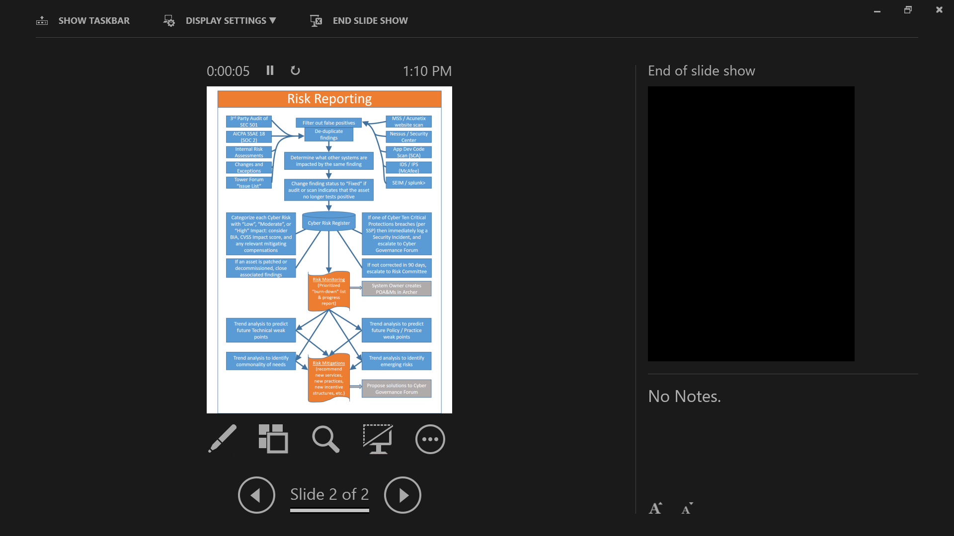
Risk Reporting – All 4 Steps, Start to Finish
Data Collection Management Reporting
Risk Monitoring, Identification and Assessment
Risk Mitigation Activities

Slide 36

Annual Report - Risk Management Data Points
Jon Smith
Director, Risk Management
ISOAG
October 3, 2018
www.vita.virginia.gov
36

Slide 37
Agenda
Risk Management Committee
SEC 520 – Risk Management standard updates
2018 National Cybersecurity Review (NCSR)

Slide 38
Risk Management Committee
Part of the VITA Platform Governance Model
Chaired by Mike Watson, CISO
Committee members consist of Agency representatives
VITA service tower forums are an operational oversight body of VITA service providers

Slide 39
Risk Management Committee
Service tower forums are staffed with CSRM risk management team members
Risks and issues within the service tower forums are tracked for timely resolution
Items that are not resolved within a timely manner are escalated to the committee
Committee reviews items and makes recommendations for escalation, such as risk alerts to other governance bodies or to the CIO

Slide 40
Risk Management Standard SEC 520
Updates to the standard:
  Align standard with new/current RM activities
  Align with changes to the Code of Virginia and Exec Order(s)
    2.2-2009 subsection C
    EO 19
  Align with the new VITA Commonwealth governance processes
Will be posted to ORCA in the very near future
  Notification will be sent when posted
  Please review, comment, and make recommendations
  30 days on ORCA

Slide 41
NCSR
Annual self assessment of Agency cyber security program maturity against the NIST Cyber Security Framework
Facilitated by DHS/CSRM using Archer
CSRM is in process of populating the 2018 NCSR questionnaire into Archer
Participation is an annual report datapoint requirement
Est. time to complete – 1 hour
Appx 115 questions
Deadline for completion Dec 15, 2018

Slide 42

Questions?
Notes:
42

Slide 43
Upcoming Events
www.vita.virginia.gov
43

Slide 44
Last IS Orientation
  The last IS Orientation for 2018 will be held on
  December 13, 2018 @1:00 PM
  CESC - Room 1221

Slide 45
Future ISOAG
November 7, 2018 @ CESC 1:00-4:00
Speakers: Carlos Rivero
Stephanie Wiliams-Hayes,VDH
Bill Freda, VITA
Kathy Bortle, VITA
ISOAG meets the 1st Wednesday of each month in 2018

Slide 46

ADJOURN
THANK YOU FOR ATTENDING
Picture courtesy of www.v3.co.uk

