Slide 1



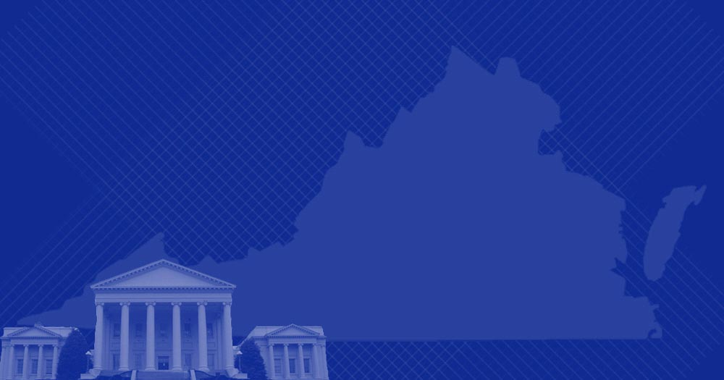
Welcome and Opening Remarks
Michael Watson
July 11, 2018
www.vita.virginia.gov
1

Slide 2
ISOAG July 11, 2018
Welcome & Opening Remarks Mike Watson, VITA
Obtaining Electronic Data-Federal & Elliott Casey,
Constitutional Law
III. Using Best Practices to Evaluate the Alex Roeglin, APA
Strength of an Organization’s Controls
IV. Next Generation Security from VITA Bill Stewart, VITA
V. Upcoming Events Mike Watson, VITA
VI. Operations Update NG

Slide 3

Government Collection of
Electronic Evidence
Elliott Casey
Staff Attorney
Commonwealth’s Attorneys’ Service Council

Slide 4
Goals for Today
Introduce the basic Constitutional, Federal legal, and Virginia legal rules regarding law enforcement collection of electronic data.
Point out the basic distinctions in types of electronic data under the law.
Introduce the basic requirements for government to collect information about users of electronic services.
KEYWORD: Basic, Basic, BASIC

Slide 5

MOST IMPORTANT RULE:
ASK YOUR LAWYER!!!

Slide 6
Two Types of Evidence
Evidence from Provider
Evidence from a Device
Usually evidence in the hands of a provider of electronic services (email, social media, etc.)
Issues:
Can they seize it?
Can they search it?
What rules limit the search?
Usually a device in Law Enforcement Possession.
Issues:
Can they seize it?
Can they search it?
What rules limit the search?

Slide 7
Evidence from Providers:
Two Axis
Time
Content v. Non-Content
Is law enforcement requesting something from the past? From the present? Or from the future?
Is law enforcement requesting something that is merely user identifying information?
Or is law enforcement requesting the “content” of the communication itself?

Slide 8
What is “Communication”
§19.2-61:
  An “electronic communication” means any transfer of signs, signals, writing, images, sounds, data, or intelligence… transmitted… by a wire, radio, or electromagnetic system.”
  This term does not include “wire or oral communications”
      Wire communications are telegrams or cables, which can still be sent – but are very rare.
      Oral communications are oral statements other than electronic communications – such as words said inside of a private home

Slide 9
4th Amendment 101
Everything you need to know
in 3 minutes or less

Slide 10
4th Amendment
The right of the people to be secure in their persons, houses, papers, and effects, against unreasonable searches and seizures, shall not be violated,
AND
No warrants shall issue, but upon probable cause, supported by oath or affirmation, and particularly describing the place to be searched, and the persons or things to be seized.

Slide 11
Two Questions:
What is a “Reasonable” search?
Is it reasonable for a government employer to search his employees computer?
Is it reasonable to pull info from a public Facebook account?
When is a warrant required?
Does it matter whether the person “owns” the data?
Does it matter what law enforcement is looking for?

Slide 12
Core Concept: “Standing”
A person can only object to a search or seizure if that person has an “expectation of privacy” in the place or thing being searched or seized.
E.g. I have an expectation of privacy in the contents of my home computer, but not in the contents of my work computer.
Question: Who owns my data?

Slide 13
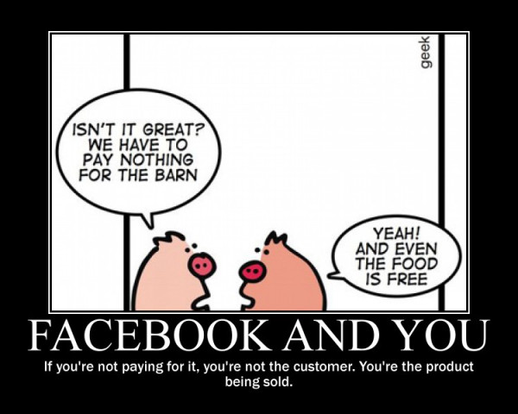

Slide 14
“Third-Party Doctrine”
In general, the Fourth Amendment does not (currently) protect data that I voluntarily turn over to a third-party.
  If I agree to let a third-party have my data and look at it whenever they want, I assume the risk that the third-party will share the data.
  Especially when I agree to let that third party sell my data!
Thus, the Fourth Amendment does not protect my data that is held by a 3rd party.
  EXCEPT WHEN IT DOES…

Slide 15
Congress’ Solution:
Create Legal Protection
1986: The “Electronic Communications Privacy Act” and “Stored Communications Act” created legal protections that regulate government access to stored and sent communications.
Those statutes, in their basic terms, are what still control today
Virginia adopted substantially similar language in the Virginia Code.
We are basically running a 2018 legal system on COBOL
  Disclaimer: As a Virginia State Employee, I am in no way implying that it would be bizarre to attempt to run a legal information system on COBOL.

Slide 16
Bottom Line
Data Held by 3rd Party
Data in My Device
Generally protected by statute only
If law enforcement wants to search, they need to comply with whatever the statutes require.
Generally protected by the Fourth Amendment
If law enforcement wants to search, they need a warrant, or my consent, or an exigent circumstance.

Slide 17
Federal Law:
Searching Third-Party Provider Data

Slide 18
Federal Code:
NON-Content
18 USC 2703(c) – Third-party providers shall turn over data pursuant to:
Search Warrant
Court Order
Subpoena (Administrative, Trial, etc.)
National Security Letter
Consent

Slide 19
Federal Code:
What is “Not Content”
18 USC 2703(c) – Examples
name;
address;
call detail records
length of service (including start date) and types of service utilized;
telephone or instrument number or other subscriber number or identity, including any temporarily assigned network address; and
means and source of payment for such service (including any credit card or bank account number)

Slide 20
Federal Code:
Content
18 USC 2703(a):
A Provider shall provide the contents of a wire or electronic communication … only pursuant to a search warrant.
Note here that it is statutory law, not the 4th Amendment, that requires the warrant.

Slide 21
New Rule: Historical
Phone Location Data
June 22, 2018
U.S. Supreme Court rules in the case of Carpenter v. United States.
The Court re-affirmed the “third party” doctrine, which holds that a person has no legitimate expectation of privacy in information he voluntarily turns over to third parties.
  For example, in the Smith case, where it had held that the phone numbers that someone dialed are not protected by the Fourth Amendment because the defendant “assumed the risk” that the company’s records “would be divulged to police.”

Slide 22
New Rule for this Data
The Court held that an individual maintains a legitimate expectation of privacy in the record of his physical movements as captured through CSLI.
As a result, the Court concluded that the Government must generally obtain a warrant supported by probable cause before acquiring such comprehensive records.

Slide 23
Why a New Rule?
Regarding CSLI, the Court found that “society’s expectation has been that law enforcement agents and others would not— and indeed, in the main, simply could not—secretly monitor and catalogue every single movement of an individual’s car for a very long period….”
“when the Government tracks the location of a cell phone it achieves near perfect surveillance, as if it had attached an ankle monitor to the phone’s user.”

Slide 24
Why It’s Different than Facebook
The Court found that cell phone location information is not truly “shared,” noting that these ubiquitous devices record a cell-site location “by dint of its operation, without any affirmative act on the part of the user beyond powering up.”
Thus, unlike the Smith case, “there is no way to avoid leaving behind a trail of location data. As a result, in no meaningful sense does the user voluntarily ‘assumed the risk’ of turning over a comprehensive dossier of his physical movements.”

Slide 25
Don’t Get Too Excited…
The Court wrote: “We do not disturb the application of Smith and Miller or call into question conventional surveillance techniques and tools, such as security cameras. Nor do we address other business records that might incidentally reveal location information. Further, our opinion does not consider other collection techniques involving foreign affairs or national security.”
Court also did not address real-time CSLI or other technologies.
Also, traditional exceptions apply, such as emergencies, threats to human life, etc.

Slide 26
Preserving but NOT Capturing Data – Yet…
Preservation Letters

Slide 27
Preservation Letters
2703 (f) Requirement To Preserve Evidence.—
(1) In general.— A provider of wire or electronic communication services or a remote computing service, upon the request of a governmental entity, shall take all necessary steps to preserve records and other evidence in its possession pending the issuance of a court order or other process.
(2) Period of retention.— Records referred to in paragraph (1) shall be retained for a period of 90 days, which shall be extended for an additional 90-day period upon a renewed request by the governmental entity.

Slide 28
Custodian of Records
Internet Provider
Address
ATTN: Compliance and Investigation Unit
RE: Preservation Request
Dear Custodial of Records:
The below listed account is the subject of an ongoing criminal investigation at this agency, and it is requested that said account and all email, and any other information contained herein, be preserved pending the issuance of a search warrant.
In particular, this agency is seeking all email account histories, buddy lists, profiles, detailed billing (log on and log off times), payment method, and other records regarding this account:
NAME: XXX
Address: XXX
Telephone: XXX
Screen Names: ______, ______, _______
If you have any questions concerning this request, please contact me at
Thank you for your assistance in this matter.

Slide 29
Virginia Law
Searching Third-Party Provider Data

Slide 30
State Code
§19.2-62 – Intentionally intercepting wire, electronic, or oral communications is a Class 6 felony
  That includes sharing information unlawfully intercepted, or using equipment to intercept communications.

Slide 31
“Interception”
Virginia is a “One-Party State”
  19.2-62(B)(2)
  “ It shall not be a criminal offense under this chapter for a person to intercept a wire, electronic or oral communication, where such person is a party to the communication or one of the parties to the communication has given prior consent to such interception.”
If one party to a communication gives prior consent to interception, it is not a violation
Some states are “Two-Party” – know any?

Slide 32
Scenario: The Computer Hacker
Hacker has been attacking my computer system
  He is using my system to distribute child pornography over the internet
  He uses my system every night at midnight
Problem: To watch him, don’t I need a Wiretap Order?

Slide 33
PATRIOT Act:
Computer Trespassers
Victims of Computer Attacks may authorize LEOs to intercept wire or electronic communications of a computer trespasser IF
  Owner/Operator of the computer authorizes the interception
  Person intercepting is lawfully engaged in investigation
  Investigator reasonably believes that the contents of the communications are relevant
  Investigator ONLY acquires communications of the trespasser

Slide 34
Virginia Code: 19.2-70.3
An“electronic communications provider is:
  any service which provides to users thereof the ability to send or receive wire or electronic communications;
A provider can be an electronic communications provider even if providing such services is not its primary business.
  Virginia Code § 19.2-61

Slide 35
BUT… Not Financial Institutions
Why do they exclude Banks?
  Because the provision of Electronic Service doesn’t have to be the primary business to qualify as an ESP
  The fact that a business conducts electronic communications can be incidental!
Example: Airline that provided computerized travel reservation system accessed through separate terminals
- U.S. v. Mullins, 992 F.2d 1472 (9th Circuit, 1993)

Slide 36
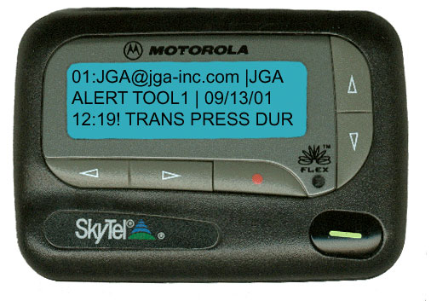
Can a Government be an Electronic Service Provider?
Note: Mere users are not providers
Example: Amazon.com user
Bohach v. City of Reno, 952 F. Supp. 1232 (D. Nev. 1996)
Held: City that provided pager service to its police officers can be a provider of electronic communication service

Slide 37
Standard for Issuing a Court Order
19.2-70.3(B)
A court order shall issue only if the law enforcement officer “shows that there is reason to believe” the records are “relevant to an ongoing criminal investigation” or missing person investigation
Note this standard is lower than “Probable Cause”

Slide 38
Emergencies
19.2-70.3(E)
Law Enforcement may also obtain real-time location data “without a warrant:”
  To respond to the user’s 911 call
  With the owner or user’s consent
  With the consent of the owner’s next of kin or guardian if the owner is missing
  If the LEO reasonably believes an emergency involving danger to a person requires the disclosure of the data

Slide 39
COMPUTER AND ELECTRONIC DEVICE SEARCH WARRANTS
Searching Devices

Slide 40
Riley v. California & U.S. v. Wurie
U.S. Supreme Court June 25, 2014
Held: Police must obtain a warrant before searching a cell phone seized incident to an arrest
  The Court rejected the argument that the data in the phone was so vulnerable as to make waiting for or obtaining a search warrant impractical.
The Court wrote that modern cell phones contain all “the privacies of life” and merit special protection.

Slide 41
Note: Exceptions still apply
The Court noted that other exceptions to the warrant requirement may still apply to searches of phones.
The Court pointed out that exigent circumstances may permit a warrantless search of a phone.
In addition, officers are still permitted to physically examine the body of a phone to, for example, determine if there was razor blade between the phone and its case.

Slide 42
What About Passwords?
What if Having a Warrant is Not Enough?

Slide 43
Can We Compel A Fingerprint?
What if a Fingerprint unlocks a phone?
“Even though the act may provide incriminating evidence, a criminal suspect may be compelled to put on a shirt, to provide a blood sample or handwriting exemplar, or to make a recording of his voice.”
  United States v. Hubbell, 530 U.S. 27, 34 (2000)

Slide 44
What About a Password?
“Compelling Defendant to provide…his passcode is compelled and testimonial and therefore protected.”
  “Defendant cannot be compelled to divulge through his mental processes his passcode.”
  However, his fingerprint is non-testimonial and does not communicate any knowledge
    Commonwealth v. Baust, 89 Va. Cir. 267
    Virginia Beach 2014

Slide 45
MOST IMPORTANT RULE:
ASK YOUR LAWYER!!!

Slide 46
Questions?

Slide 48
Presentation Overview
Introduction & Speaker Biography
Industry Best Practices
  Center for Internet Security Benchmarks
  Center for Internet Security Critical Controls
  US DoD Security Technical Implementation Guides
  Open Web Application Security Project
Using Best Practices to Evaluate Controls
  Selecting a Best Practice
  Building an Audit Program
  Control Evaluation Tools
Conclusion & References

Slide 49
Presentation Overview
Introduction & Speaker Biography
Industry Best Practices
  Center for Internet Security Benchmarks
  Center for Internet Security Critical Controls
  US DoD Security Technical Implementation Guides
  Open Web Application Security Project
Using Best Practices to Evaluate Controls
  Selecting a Best Practice
  Building an Audit Program
  Control Evaluation Tools
Conclusion & References

Slide 50

Speaker Biography
48 different information systems security related audits
B.S. Information Systems & B.S. Business Management from Liberty University
Certified Information Systems Auditor (CISA)
I enjoy the outdoors and commentating sports to my wife and daughters (who are both under 2!)

Slide 51
Presentation Overview
Introduction & Speaker Biography
Industry Best Practices
  Center for Internet Security Benchmarks
  Center for Internet Security Critical Controls
  US DoD Security Technical Implementation Guides
  Open Web Application Security Project
Using Best Practices to Evaluate Controls
  Selecting a Best Practice
  Building an Audit Program
  Control Evaluation Tools
Conclusion & References

Slide 52
Center for Internet Security Benchmarks
Non-profit independent organization
Best practices for securing IT systems and data against the most pervasive attacks
Developed by volunteer subject matter experts from backgrounds in consulting, software development, audit/compliance, security research, operations, government, and legal
Available in PDF, Word, Excel, and XML formats (through SecureSuite)
Source Reference: 1

Slide 53
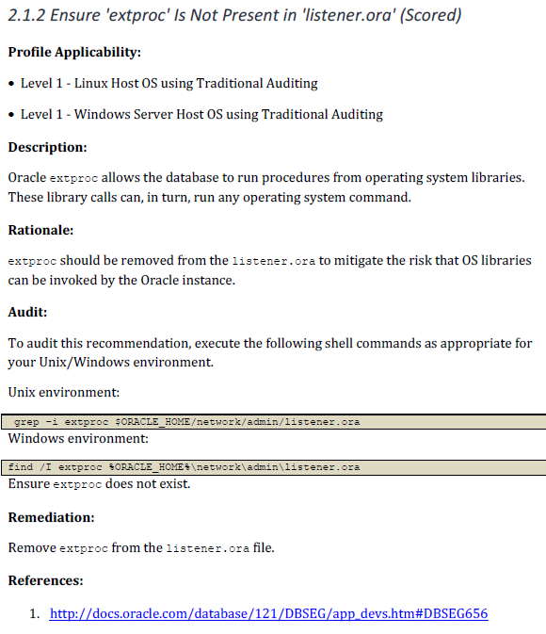
CIS Benchmark Example
Source Reference: 2

Slide 54
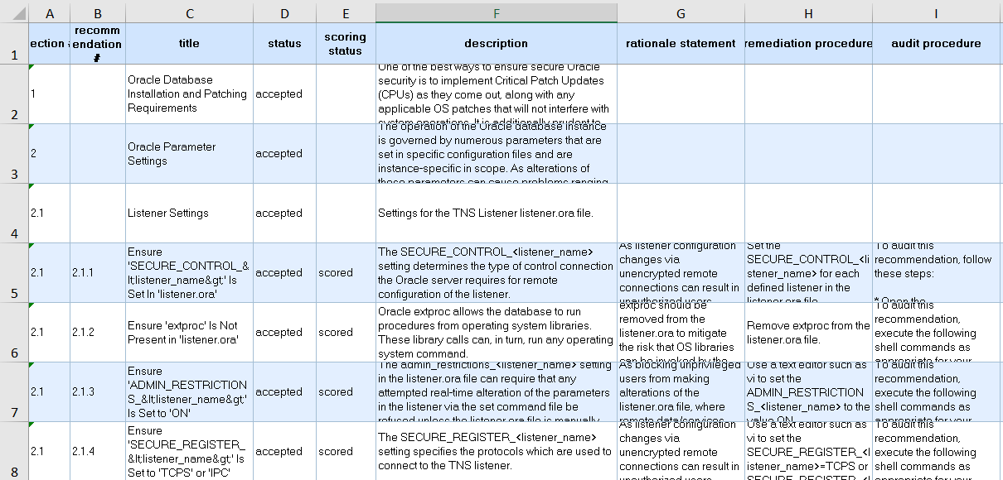
CIS Benchmark Example (cont.)
Source Reference: 2

Slide 55
CIS Critical Controls for Effective Cyber Defense
Focuses on the most fundamental and valuable actions every enterprise should take (Sometimes referred to as the “SANS Top 20”)
20 recommended controls (foundational and advanced)
5 critical tenets of each control: Offense informs defense, Prioritization, Metrics, Continuous diagnostics and mitigation, and Automation
Source Reference: 3

Slide 56
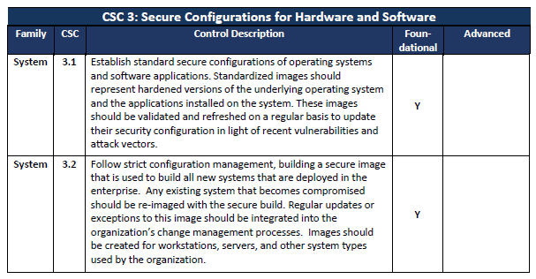
CIS Critical Control Example
Source Reference: 3

Slide 57
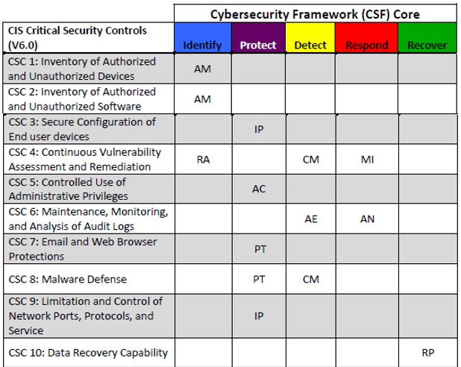
Critical Controls for Effective Cyber Defense
Source Reference: 3

Slide 58
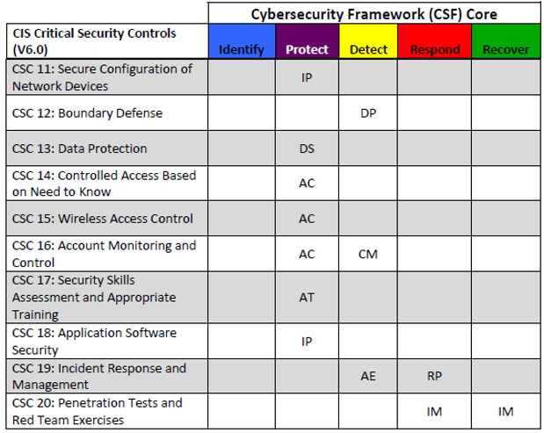
Critical Controls for Effective Cyber Defense (cont.)
Source Reference: 3

Slide 59
US DoD Security Technical Implementation Guides
Defense Information Systems Agency Security Technical Implementation Guides (DISA STIG)
Configuration standards for US DoD devices/systems
Based on requirements in NIST SP800-53r4 and other special publications
Vulnerabilities are classified by severity (CAT1 is most severe, CAT3 is least)
Source Reference: 4

Slide 60
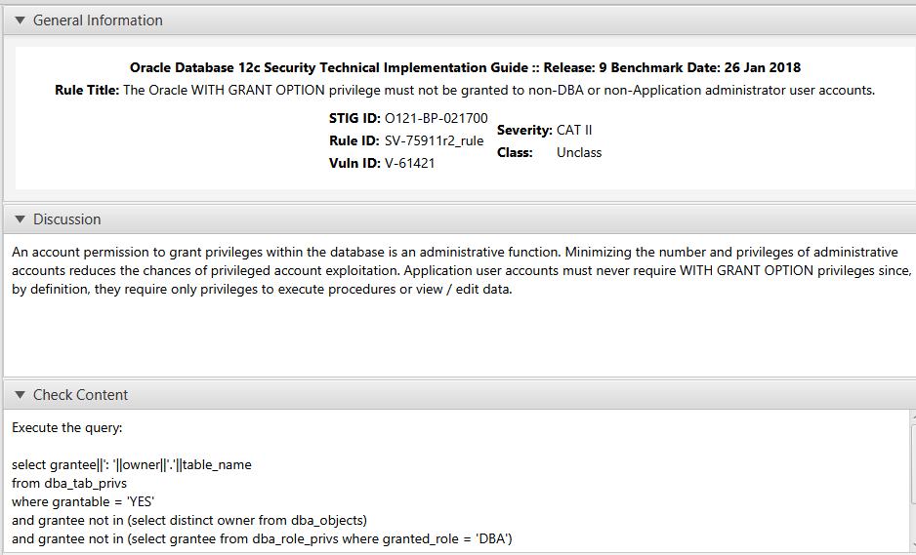
STIG Example
Source Reference: 5

Slide 61
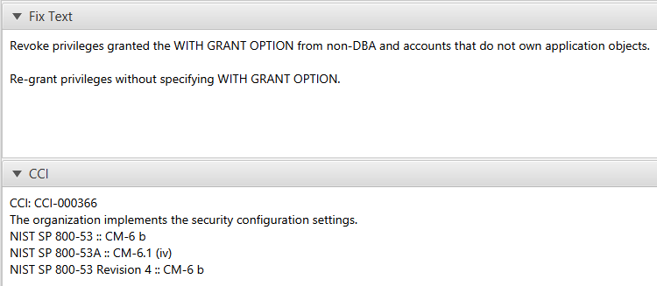
STIG Example (cont.)
Source Reference: 5

Slide 62
OWASP Proactive Controls
Open Web Application Security Project (OWASP)
“OWASP is an open community dedicated to enabling organizations to conceive, develop, acquire, operate, and maintain applications that can be trusted”
Source Reference: 6

Slide 63
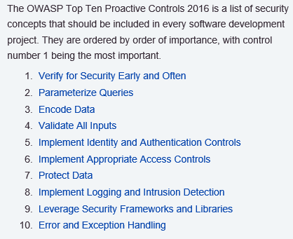
2016 Top Ten Proactive Controls
Source Reference: 7

Slide 64
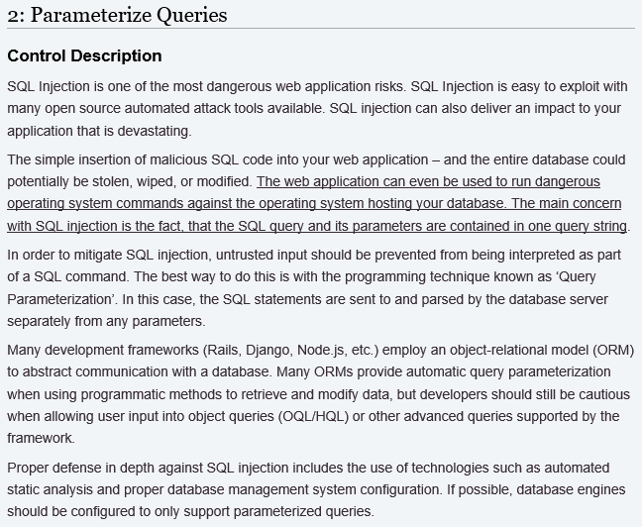
Proactive Control Example
Source Reference: 7

Slide 65
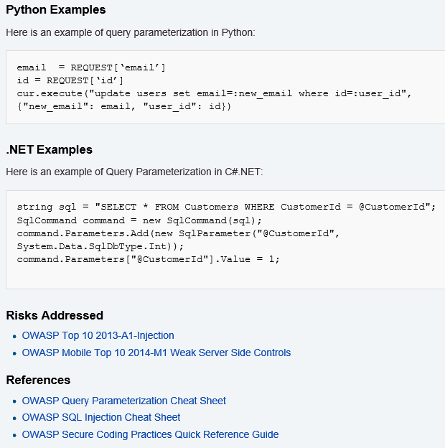
Proactive Control Example (cont.)
Source Reference: 7

Slide 66
Presentation Overview
Introduction & Speaker Biography
Industry Best Practices
  Center for Internet Security Benchmarks
  Center for Internet Security Critical Controls
  US DoD Security Technical Implementation Guides
  Open Web Application Security Project
Using Best Practices to Evaluate Controls
  Selecting a Best Practice
  Building an Audit Program
  Control Evaluation Tools
Conclusion & References

Slide 67
Selecting a Best Practice
Some questions you could ask when selecting a best practice as the framework for the evaluation:
  Do I need guidance on a specific type of technology?
  Do I care if the vulnerabilities are categorized according to severity?
  Do I care if the controls are mapped to a specific security standard?
  How many resources can I allocate to the evaluation?

Slide 68
Center for Internet Security Benchmarks
+Customized for specific technologies
+Includes guidance on evaluating and altering the control
+Includes explanation of risks and severity classification (scored vs not scored)
+Minimal resources required for evaluation
+Includes references to vendor documentation for additional research
-Not mapped to security standards or special publications
-PDFs not easily converted into other document formats (SecureSuite membership required for Word, Excel, and XML formats)

Slide 69
Center for Internet Security Critical Controls
+Mapped to NIST Cyber Security Framework
+Controls are classified as ‘Foundational’ or ‘Advanced’
+Includes explanation of risks
-Not technology specific
-Does not provide specific technical guidance
-May require significant resources to investigate and resolve

Slide 70
Security Technical Implementation Guides
+Customized for specific technologies
+Includes guidance on evaluating and fixing the control
+Includes explanation and categories of risk
+Mapped to NIST special publications (including 800-53r4)
+Easy to search, track progress, and document
+Easy to convert to other document formats
-Guidance is based on DoD’s recommended controls and specific environments
-Lacks flexible control descriptions “If the control is not configured this way this is a finding…”

Slide 71
OWASP Proactive Controls
+Provides guidance in multiple web environments
+Includes explanation of risks
+Includes references to cheat sheets and other OWASP tools
-Is not mapped to security standards
-Not easily converted into other document formats
-Not always user friendly or easily searchable

Slide 72
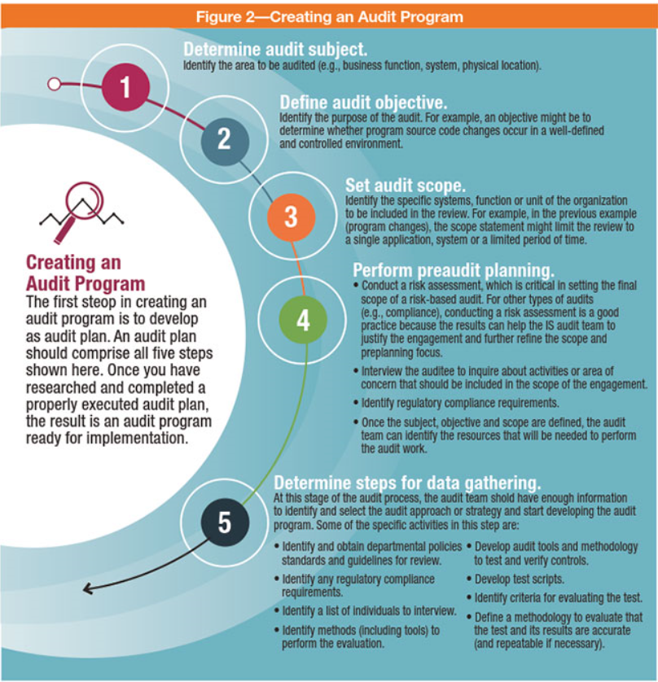
Building an Audit Program, An ISACA Approach
Source Reference: 11

Slide 73
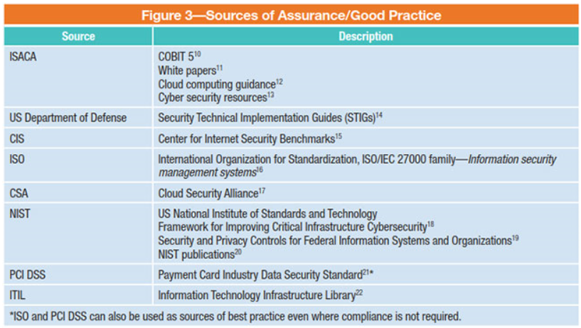
ISACA Recommended Best Practice Sources
Source Reference: 11

Slide 74
Building Audit Programs, An APA Approach
Determine appropriate amount of coverage required
Evaluate risk associated with each control and its impact from a coverage perspective
Consider resource constraints and expertise
Prioritize controls
Continuous Improvement!

Slide 75
Building Audit Programs, An APA Approach
Factors to Consider:
Select controls to test (document justification)
Build/test/update audit program (version control)
Identify changes in standards, technology, and best practices
Map controls to requirements
Security Standard Requirements
Type of Audit
Organizational Risks
Auditing Standards
System/data classification and criticality
Resource limitations
Continuous Improvement!

Slide 76
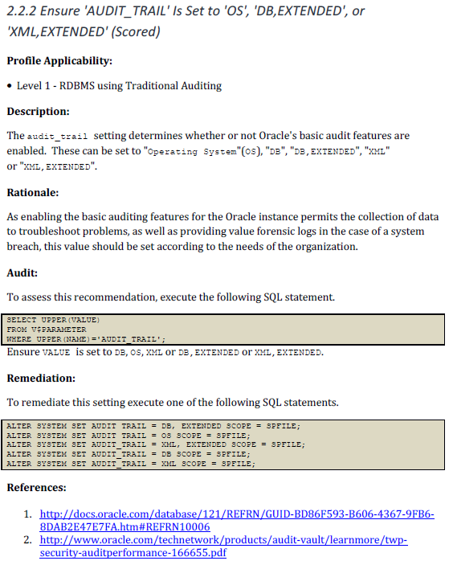
Conversion Example 1 (CIS Benchmark)
Source Reference: 2

Slide 77
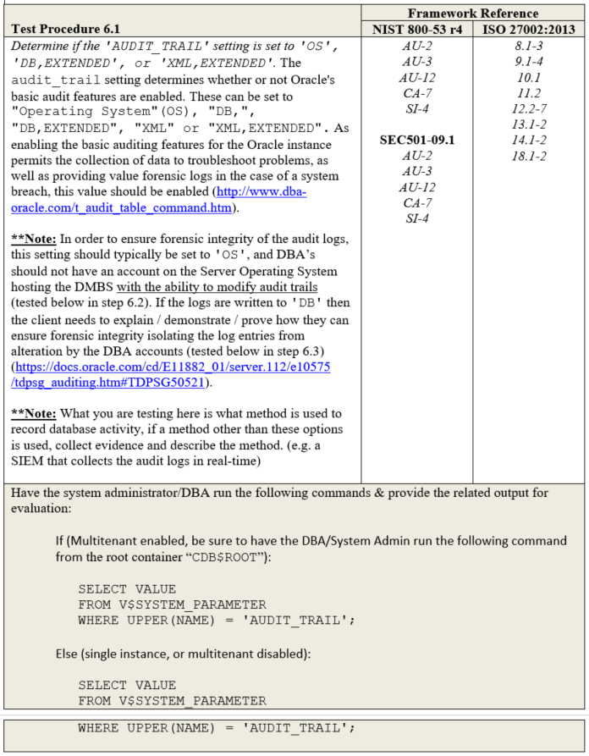
Conversion Example 1 (cont.)
Source Reference: 8

Slide 78
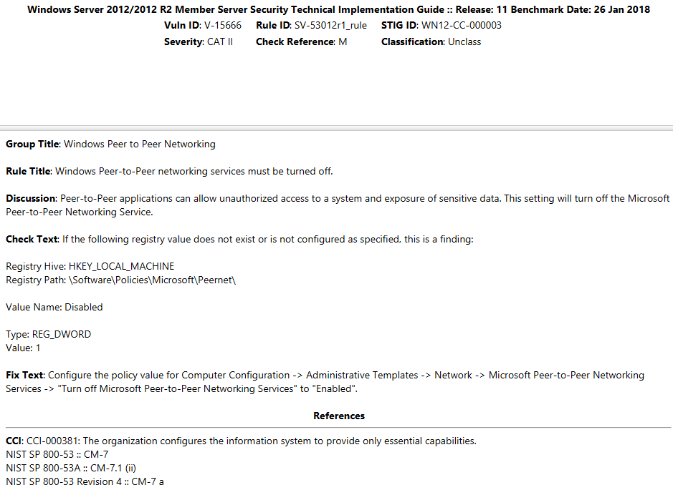
Conversion Example 2 (STIG)
Source Reference: 9

Slide 79
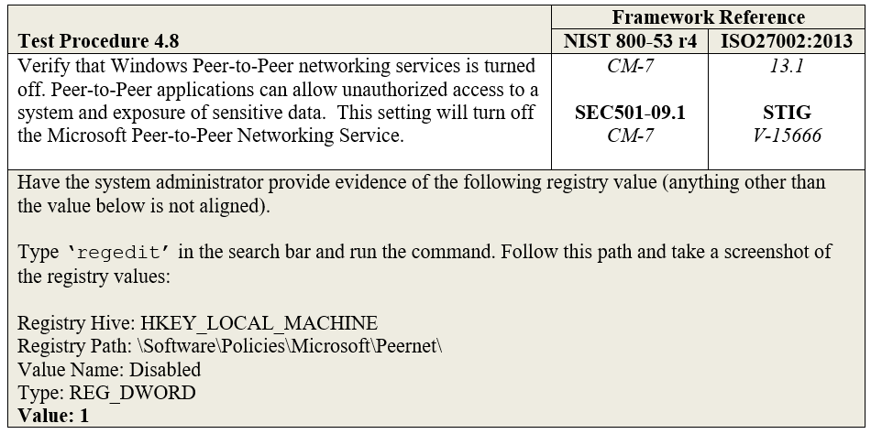
Conversion Example 2 (cont.)
Source Reference: 10

Slide 80
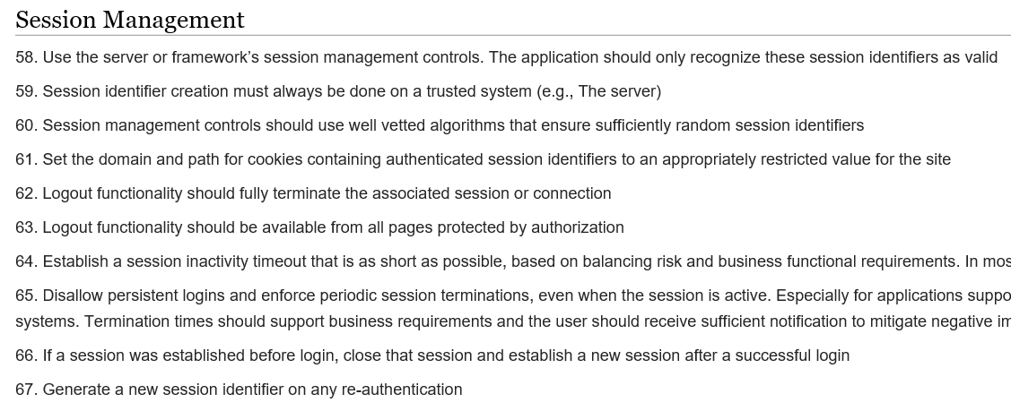
Conversion Example 3 (OWASP)
Source Reference: 12

Slide 81
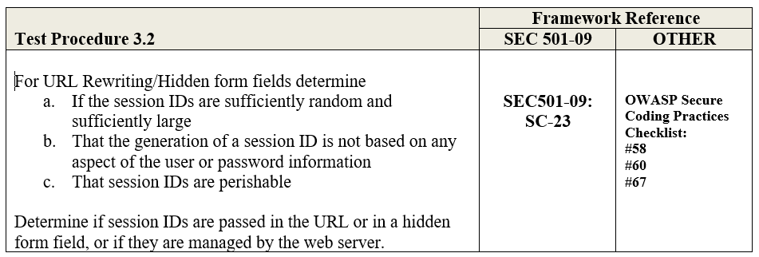
Conversion Example 3 (cont.)
Source Reference: 13

Slide 82
Control Evaluation Tools
General
Compliance scanning (Nessus, Nipper, etc.)
STIG Checklists
Center for Internet Security-Configuration Assessment Tool (CIS-CAT Pro)
Web Applications
Qualys SSL Labs
Websniffer

Slide 83
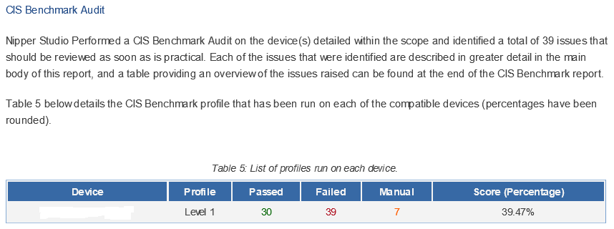
Best Practice Compliance Scanning
Source Reference: 14

Slide 84
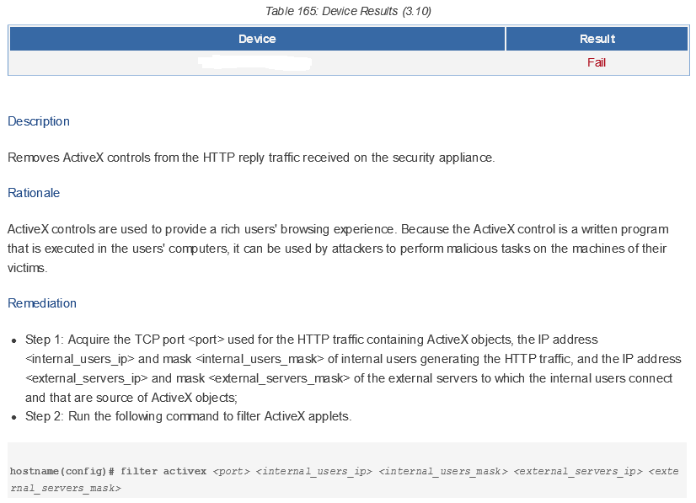
Best Practice Compliance Scanning (cont.)
Source Reference: 14

Slide 85
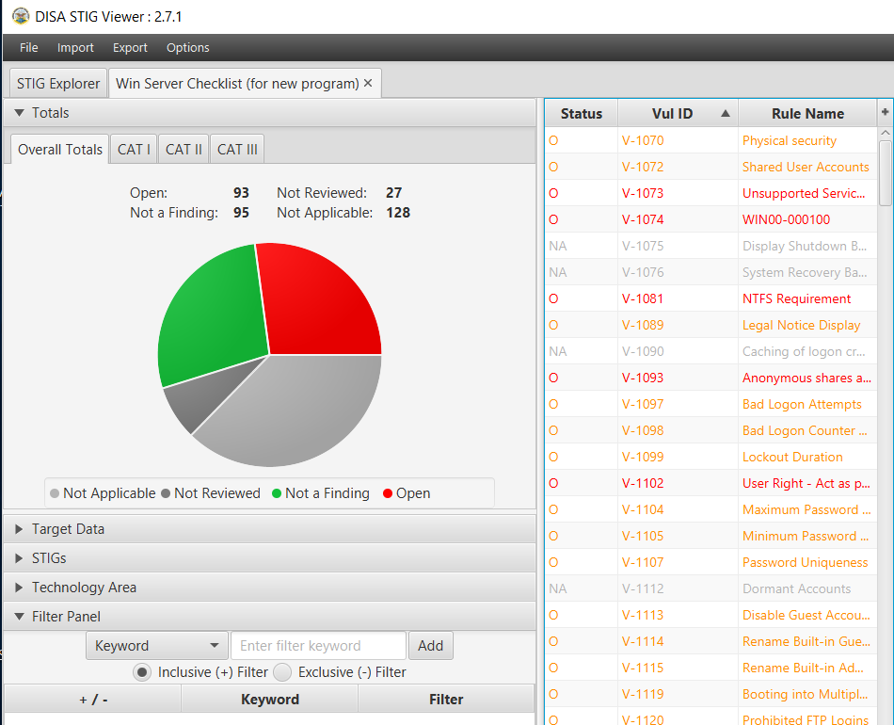
STIG Checklists
Source Reference: 15

Slide 86
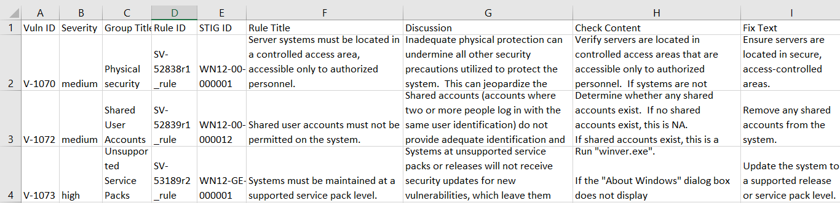
STIG Checklists (cont.)
Source Reference: 16

Slide 87
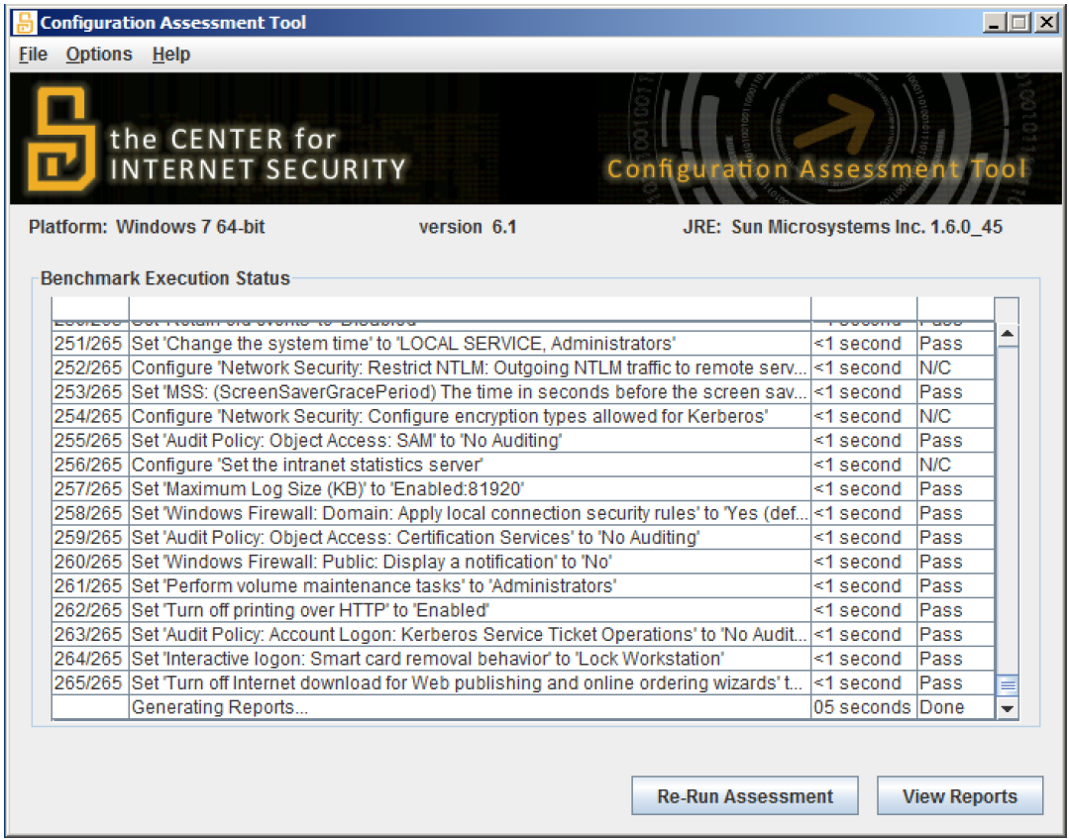
CIS-CAT Pro
Source Reference: 17

Slide 88
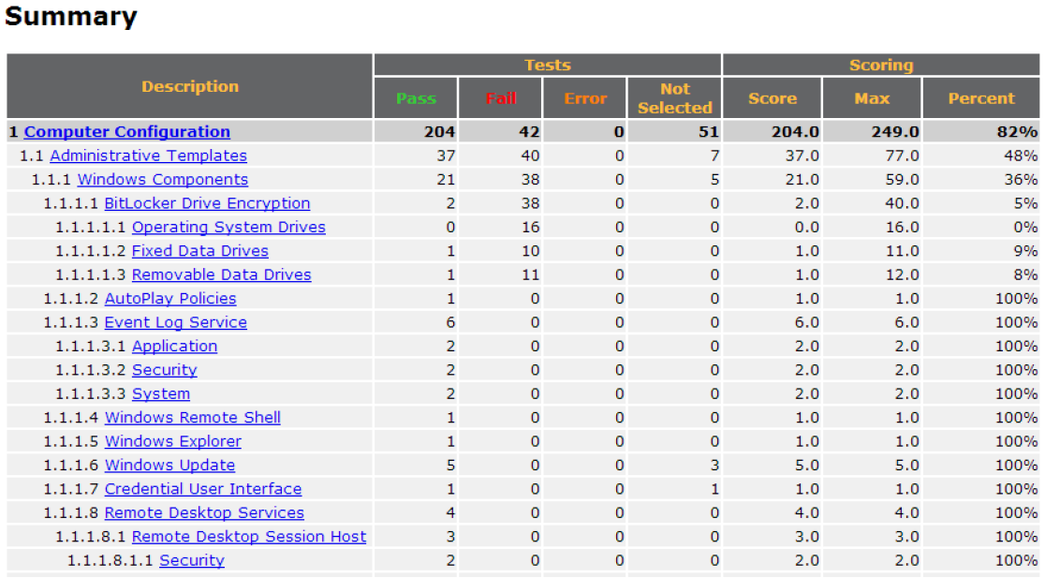
CIS-CAT Pro (cont.)
Source Reference: 17

Slide 89
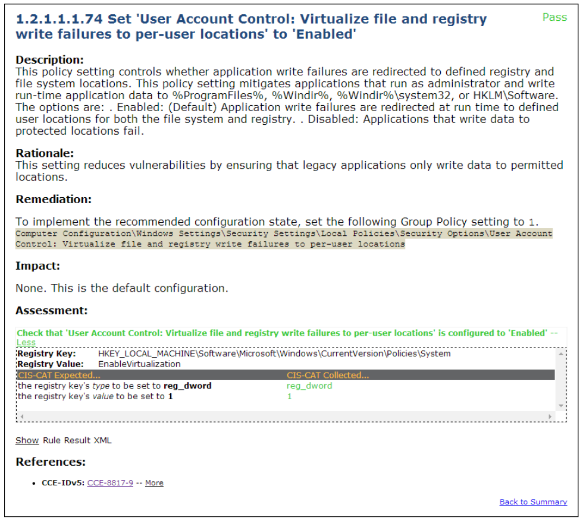
CIS-CAT Pro (cont.)
Source Reference: 17

Slide 90
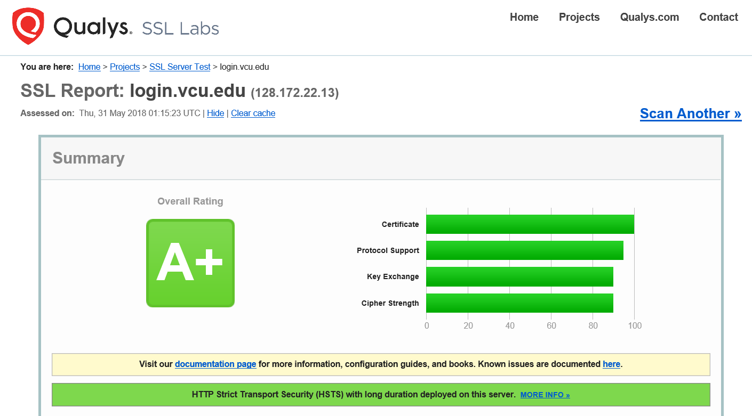
Qualys SSL Labs
Source Reference: 18

Slide 91
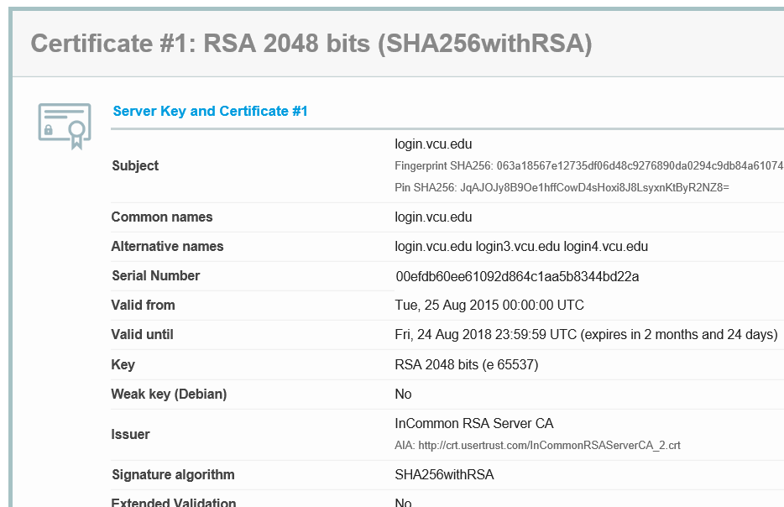
Qualys SSL Labs (cont.)
Source Reference: 18

Slide 92
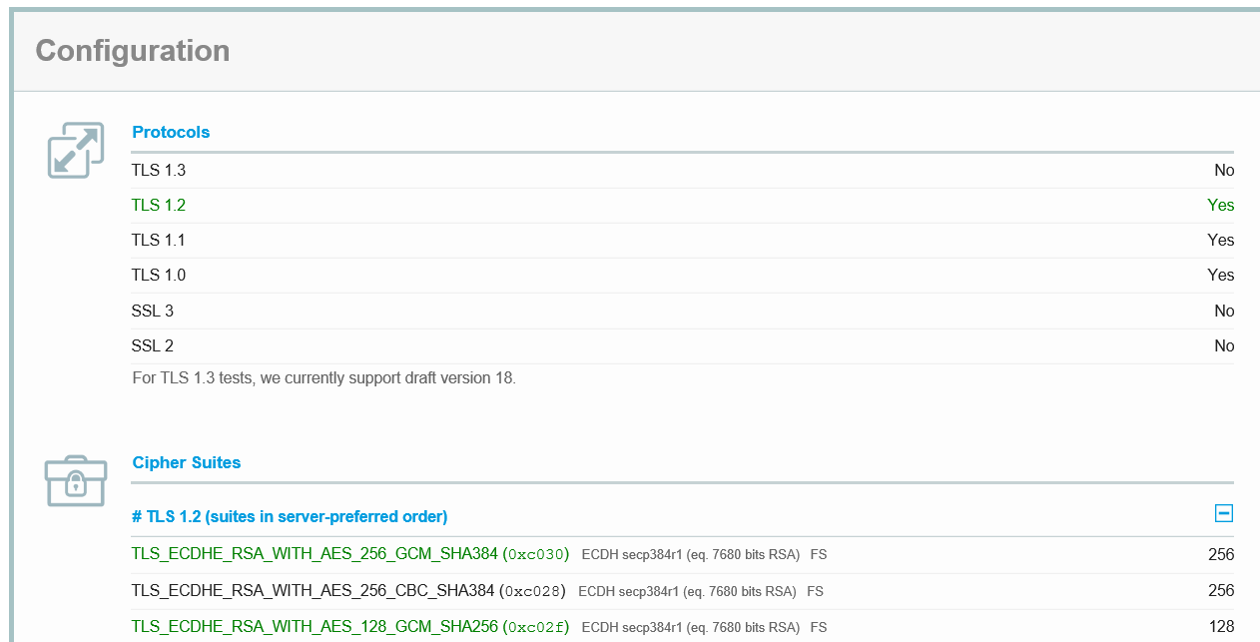
Qualys SSL Labs (cont.)
Source Reference: 18

Slide 93
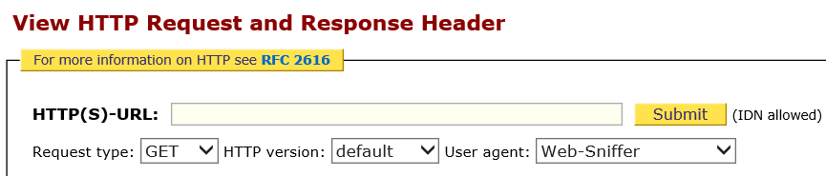
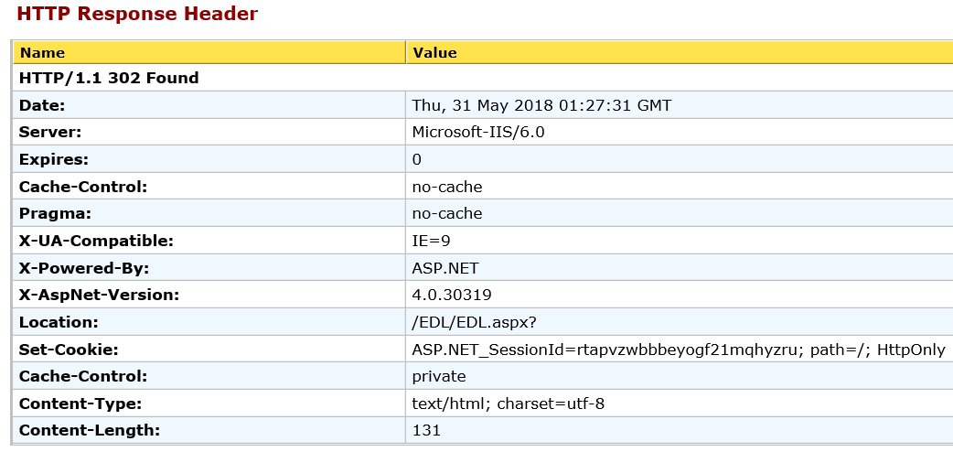
Web Sniffer
Source Reference: 19

Slide 94
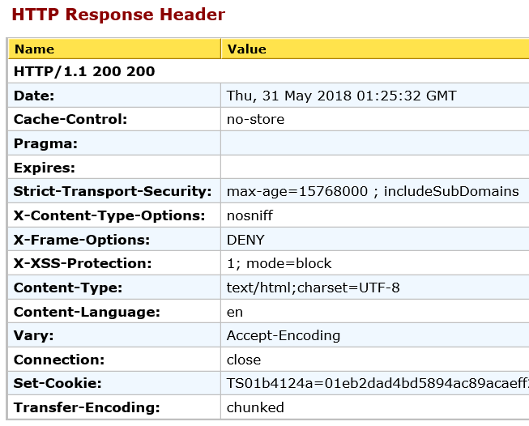
Web Sniffer (cont.)
Source Reference: 19

Slide 95
Presentation Overview
Introduction & Speaker Biography
Industry Best Practices
  Center for Internet Security Benchmarks
  Center for Internet Security Critical Controls
  US DoD Security Technical Implementation Guides
  Open Web Application Security Project
Using Best Practices to Evaluate Controls
  Selecting a Best Practice
  Building an Audit Program
  Control Evaluation Tools
Conclusion & References

Slide 96
Questions?

Slide 97
References & Links
1. https://www.cisecurity.org/about-us/
2. CIS Oracle Database 12c Benchmark 2.0.0 (page 23, 30), available at https://downloads.cisecurity.org/download-issues/benchmarks (Additional example in Excel format)
3. CIS Critical Security Controls for Effective Cyber Defense_v6.1 (page 3, 78-79), available at https://learn.cisecurity.org/20-controls-download
4. https://iase.disa.mil/stigs/Pages/index.aspx
5. Oracle 12c Database STIG – Ver 1, Rel 9 (V-61241), available at https://iase.disa.mil/stigs/app-security/database/Pages/index.aspx

Slide 98
References & Links (cont.)
6. https://www.owasp.org/index.php/About_The_Open_Web_Application_Security_Project
7.https://www.owasp.org/index.php/OWASP_Proactive_Controls#tab=OWASP_Proactive_Controls_2016
8. Database – Oracle 11g and 12c Audit Program v2.2, available upon request to APA ISS Team
9. Windows Server 2012 R2 STIG - Ver 2, Rel 11, available at https://iase.disa.mil/stigs/os/windows/Pages/index.aspx
10. OS – Windows Server 2012 R2 Audit Program v1.0, available upon request to APA ISS Team

Slide 99
References & Links (cont.)
11. IS Audit Basics – Audit Programs (by ISACA), available at https://www.isaca.org/Journal/archives/2017/Volume-4/Pages/audit-programs.aspx
12. OWASP Secure Coding Practices Checklist, available at https://www.owasp.org/index.php/OWASP_Secure_Coding_Practices_Checklist
13. Application – Web Application Audit Program for non-Partnership Agencies v2.3, available upon request to APA ISS Team
14. This is an example report produced using Nipper Studio, additional information about Nipper Studio is available at https://www.titania.com/nipper-studio
15. This is an example of a Windows Server 2012 R2 STIG checklist using the STIG Viewer Application, available at https://iase.disa.mil/stigs/Pages/stig-viewing-guidance.aspx

Slide 100
References & Links (cont.)
16. This is an example of a Windows Server 2012 R2 STIG checklist exported to Excel format. The Windows Server 2012 R2 STIG is available at https://iase.disa.mil/stigs/os/windows/Pages/index.aspx
17. CIS-CAT Users Guide, available through a CIS Secure Suite membership, additional information is available at https://www.cisecurity.org/introducing-cis-cat-pro/
18. This is an example SSL report produced by Qualys, available at https://www.ssllabs.com/ssltest/
19. This is an example header sanitization evaluation report, available at http://websniffer.cc/

Slide 101


VITA’s Next Generation Security
Bill Stewart-VITA
Service Owner, Security Operations
ISOAG Meeting
July 11,, 2018
www.vita.virginia.gov
101

Slide 102

Next Generation VITA Security
What ARE we getting??
Intros
New VITA Model
New MSS Supplier
Overview of Security Service
  What’s New/Different
Wrap up
Q/A

Slide 103
Still Early
Informal Sneak Preview-Things could change.
Many details (availability dates, rates) still TBD.
Goal- Provide an overview of the new MSI model and how security (in general)/Security Services will be delivered with the new VITA model.
Needs a little time-Takeover In Place (Nov./Dec.) then migrate to new solutions.

Slide 104
New VITA Model-MSI-STS
MSI
  Keystone/Central Spoke for Suppliers
  Cross-functional Services
  VITA’s Service Management Portal
STS- Service Tower Supplier
  Managed Security (MSS)
  Messaging
  Mainframe
  EUS/Managed Print
  Voice/Network
  Server/Storage/Datacenter
Notes:
MSI- Keystone/Central Spoke- All others must follow rules to “play in the sandbox” (SLAs, OLAs, etc)
MSI-VITAs central point of requesting services, help desk, and accessing dashboards

Slide 105
New Security Model
MSS- Will provide services to program STS’ and customers
Example-MSS scan and report vulnerabilities/compliance issues to MSI.
  Each STS responsible to configure and patch their assets
  STS separation of duties. Difficult to conceal vulnerability/compliance issues.
  QA/QC through SLA/OLAs
More services for entities outside of The Program (Authorized Users)
Notes:
For authorized users- Many services set up in a way that removes program overhead from the consumable units. Some but not all services would involved a work/implementation charge between MSS and the Authorized user and the authorized users would consume those services at a set rate.
Much of the offered services and rates is still TBD.

Slide 106
Security Services Delivery
Service Management Framework
for Integrated Services Platform
Security Services Provider
Threat Management
Perimeter Security
Network Security
Endpoint Security
Application Security
Data Security
Infosec Management
Multisourcing Service Integrator
Security
Security
Tower
Tower
Tower
Tower
Tower
Cloud
Retained

Slide 107
Introducing MSI and MSS
MSI- SAIC
  Awarded August 2017
  Presenting Friday
MSS-Atos
  Awarded February 2018
  France based/Operate 73 countries
  100,00 employees/4500 for security
  14 SOCs/ 100M events per hour
  6.5M traditional and IoT endpoints monitored
  Technology/Cyber partner Olympic Games
  Experience in State/Local/Edu and MSI construct
  Familiar with VITA and Customer Agency needs
Notes:
Atos North America
State Local- Texas, Georgia, North Carolina, New Jersey, multiple other states/localities and Universities
MSI construct-with Texas, Georgia (plus multi sourced environments with others in public/edu sector)
14 SOCS / 4500 Security Pros
100 million security events per hour
6.5 million traditional/IoT endpoints monitored

Slide 108
Security Scope: Incidents >> Breaches
Traditional (Incidents)
  AV/Firewalls/IPS/SIEM/Web Security/etc.
  Baked into VITA Services
  Experience with many current tools-Smoother transition
New capabilities (Breaches*)
  Upper Layer Firewalls (4 to 7)*
  WAF*
  Source Code Scanning*
  Privileged Account Management* (MSI tool)
  Spam/Phishing Protection*(Messaging Tool)
  DLP*
  E-discovery “Vault”
  NAC (Part of Compliance)
  Encryption (File-Folder/Tokenization)
  Certificate/Key Management Platforms
  *Phishing/Application Layer/Privileged Accounts- Where most breaches are occurring
Notes:
CIA that established the VITA-NG partnership covered Infrastructure. Threat landscape has evolved over time.
Verizon and other reports- 80 to 90% of BREACHES are occurring due to phishing/application attacks and misuses of privileged accounts.

Slide 109
MSS Scope of Duties
Notable Items NOT in MSS Scope
  Email/SPAM Security- (Tempus Nova/Google)
  Privileged Account Management (SAIC)
  Remote Access VPN (SSDC)
  Point to Point Tunnels (SSDC)
  Mainframe ACF2 (DXC)
  Encryption of Databases** (SSDC)
  Database Security (SSDC)
  Volumetric DOS (VDN)
  Patching/Configuring other STS’s
Notes:
More than 50% of COV incidents were from phishing attacks.

Slide 110
New MSS/STS/Agency Interactions
Platform Tools
WAF rulesets
NAC
Encryption Key Management Platform
Certificate Management Platform
Vulnerability scans…”fragile systems” (STS, Agency)
Layer 4-7 firewalls
“Optional” Items
Encryption (database, file/folder, etc.)
DLP/e discovery
“Legacy services”- Firewalls, Application Whitelisting, etc.
Notes:
Other towers will also have new Interactions- Just one example MSI will have Privileged Account Management system likely needing STS/Agency interaction.
SC-12 CRYPTOGRAPHIC KEY ESTABLISHMENT AND MANAGEMENT- “…The organization establishes and manages cryptographic keys…” SC-13-COV- “…
Vulnerability Management- More comprehansive scans…alerts/exception requests for “fragile systems”

Slide 111
Compliance and Audits
And Security Incidents**
Multiple Vendors
Leverage MSI
  Coordinate Audit/Follow Up Activities
    Cooperation/Documentation among STS’s
    Tracking STS POAMs
MSS Tools Help Validate
Security Incidents…ditto
  MSS runs, MSI coordinates

Slide 112

Seem Complicated?
New Model-
More Suppliers?
More toolsets?
More complexity?
Fortunately-
Not your problem:
Performance >> MSI
Interoperability >> MSI
Simplicity >> MSI
VITA is accountable
Notes:
Might be used to just having to deal with one supplier
Good news- agency ISO not expected to explain act as interface to their management
Think of RACI
Supplier Responsible for service delivery
MSI responsible for providing a seamless integration of the STS
VITA is ultimately accountable

Slide 113
Resource Unit Family
Monitoring, Reporting and response
MSS RUs | Definition | Units
Security Incident Management | The management of Security Incidents assigned to the Supplier, including Security Incident response; and the Services necessary to resolve Security Events | Fixed Fee
Digital Forensic Investigation | The specialized work that prepares an organization to prosecute for a data breach, theft or loss. | Fixed Fee
Response Preparedness | The major Incident (emergency) response process defined as part of the security plan that needs to be exercised every time the plan changes or every other year. | per Response Readiness Test
Security Monitoring, Log Management, & Analysis | The collection, aggregation and retention of system logs and the monitoring and analysis of that data from connected devices. | per Device Monitored

Slide 114
Resource Unit Family -
Network and Platform Protection
N-New O-Optional D-Different
MSS RUs | Definition | Units
Desktop Encryption ~N | Portable Devices or Desktops with VITA’s required endpoint encryption solution installed and managed by Supplier | per Device
Desktop Managed Host Intrusion Protection, Firewall, & Antivirus | The Desktops monitored by the Supplier using the host based intrusion detection system | per Desktop
Server Encryption -N | Servers in with VITA’s required endpoint encryption solution installed and managed by Supplier | per Device
Server Managed Firewall and Antivirus | Managed antivirus (Malware Protection) and Firewall solution, provided by Supplier for Servers | per Server
Server Managed Host Intrusion Protection | Managed services provided to servers monitored by the Supplier using the host based intrusion detection system | per Server
Managed Network Intrusion Protection | Services managed by Supplier and used to provide Managed Network Intrusion Protection (100 MB / 1 GB / 10 GB of effective throughput) | per Unit
Data Loss Prevention -N, O | End users utilizing the Supplier provided Data Loss Prevention service | per User
Web Content Monitoring | Monitoring and filtering by a device that is connected to the VITA Network by the Supplier to monitor and filter content (650 Mbps / 1350 Mbps/ 4200 Mbps of effective throughput) | per Unit

Slide 115
Resource Unit Family -
Network and Platform Protection- Continued
N-New O-Optional D-Different
MSS RUs | Definition | Units
Managed Firewall -D | Managed traffic inspected by a firewall device managed (blocked or not) and include the firewall hardware, software, design, installation, maintenance and management (100 MB / 1 GB / 10 GB) | per Unit
Vulnerability Scanning -D | Active IP addresses scanned as part of a regular or scheduled scan of the environment to detect vulnerabilities | IP Addresses
Application Scanning –N, D | Scanning of website URLs to detect vulnerabilities (exposed to the internet or restricted to internal segments) | per URL
Penetration Testing | Regular or scheduled scanning of website URLs to detect vulnerabilities (exposed to the internet or restricted to internal segments) | Fixed Fee
Compliance Testing -N, D | Aggregate number of network or endpoint devices receiving compliance testing | per Device
Application Process Whitelisting ~N, O | Devices receiving Application Process Whitelisting and Endpoint File Integrity Checks | per Device

Slide 116
Resource Unit Family-
Network and Platform Protection- 3
N-New O-Optional D-Different
MSS RUs | Definition | Units
Full Packet Capture | Amount of Full Packet Capture services for Legacy systems, DC appliances, 44TB storage and remote appliances) | Fixed Fee
WAF -N, O | Amount of Web Application Firewalls managed by Supplier for low, medium and high capacity consumption, as well as legacy and cloud instances | per Unit
File Level Encryption -N, O | Users receiving File Encryption Services | per User
e-Discovery -N, O | Devices receiving e-Discovery Services | per Device
Tokenization License -N, O | Annual license subscriptions utilized for Tokenization | per Annual License
Managed Encryption Platform –N, D | Up to 1,000,000 maximum keys and/or 1,000 concurrent connections | Fixed Fee
Encryption License -N, O, D | Annual license subscriptions utilized for Encryption services as part of the Managed Encryption Platform Service, including: File protection, application layer encryption, database native, KMIP connector, VM encryption, database encryption | per Annual License
Source Code Scanning -N, O | Annual subscriptions utilized for Source Code Scanning, including 7 types of licenses | per Annual License

Slide 117
Resource Unit Family-
Network and Platform Protection-4
N-New O-Optional D-Different
MSS RUs | Definition | Units
Certification Management Solution -N, O | Aggregate number of server or end user devices receiving Certificate / Key Management services | per Server Device
Managed Virtual Firewall -N, O | Firewalls managed in the virtual environment (5 types) | per Unit
Sandbox -N | Annual License Subscriptions utilized for enhanced security capabilities for the physical 10GB and 1GB firewalls | per Annual License
Firewall Self-Service Platform -N, O | Additional firewall capabilities for user reporting, change management automation, application performance metrics | Fixed Fee
Topology/Firewall Workflow -N, O | Annual License Subscriptions utilized for Firewall Self-Service Platform Services elements | per Annual License
Business Connectivity Visualizer- N, O | Annual License Subscriptions utilized for Firewall Self-Service Platform Services elements | per Annual License
Cloud Access Security Broker (CASB) -N, O | Aggregate number of End Users receiving Cloud Access Security Broker service | per User

Slide 118

Next Generation Security
What are we getting?
The Security we ALWAYS wanted…
Experienced Suppliers
Improved Accountability
Advanced Toolset
Application Layer
Breach Protection
Better Service Catalog
Better $$ Transparency
Notes:
Better Service Catalog- More services, easier for authorized users to consume.

Slide 119
Questions?
Contact Info:
Bill Stewart
bill.stewart@vita.virginia.gov
Managed Security Contract Documents Link:
https://www.vita.virginia.gov/services/it-infrastructure-services/
Notes:
Some contract documents have been redacted for security reasons. If you want to see those redacted items, recommend going through your agency ISO or if you are an ISO contact CSRM…same as you would for the security products roadmap documents.

Slide 120
Upcoming Events
www.vita.virginia.gov
120

Slide 121
Future ISOAG
August 01, 2018 @ CESC 1:00-4:00
Speakers: David Brown, DBHDS
Prentice Kinser, SAIC
Kathy Bortle, VITA
Dean Johnson , VITA
ISOAG meets the 1st Wednesday of each month in 2018

Slide 122
ISO/AITR APPROVERS LIST
Please review your agency ISO/AITR approvers list and contact Tina Harris-Cunningham if you have any questions or updates.
Email: Tina.Harris-Cunningham@vita.virginia.gov

Slide 123

ADJOURN
THANK YOU FOR ATTENDING
Picture courtesy of www.v3.co.uk

