Slide 1
ISOAG Meeting
January 10, 2018
Welcome to CESC

Slide 2




Welcome and Opening Remarks
Michael Watson
January 10, 2018
www.vita.virginia.gov
2

Slide 3
ISOAG January 10, 2018
Welcome & Opening Remarks Mike Watson, VITA.
‘Day in the Life’ from the David Hogue, NSA
Operations Center perspective
III. Cybersecurity: Decisions, Habits, Servio Medina, DHA
Hygiene
IV New InfoSec Responsibilities And Chuck Ross, Impactmakers
Opportunities for Success
V. Upcoming Events Mike Watson, VITA
VI. Operations Update NG

Slide 4
DAVE HOGUE
Technical Director
NSA Cybersecurity Threat
Operations Center (NCTOC)
THE OVERALL CLASSIFICATION OF THIS BRIEF IS
UNCLASSIFIED

Slide 5
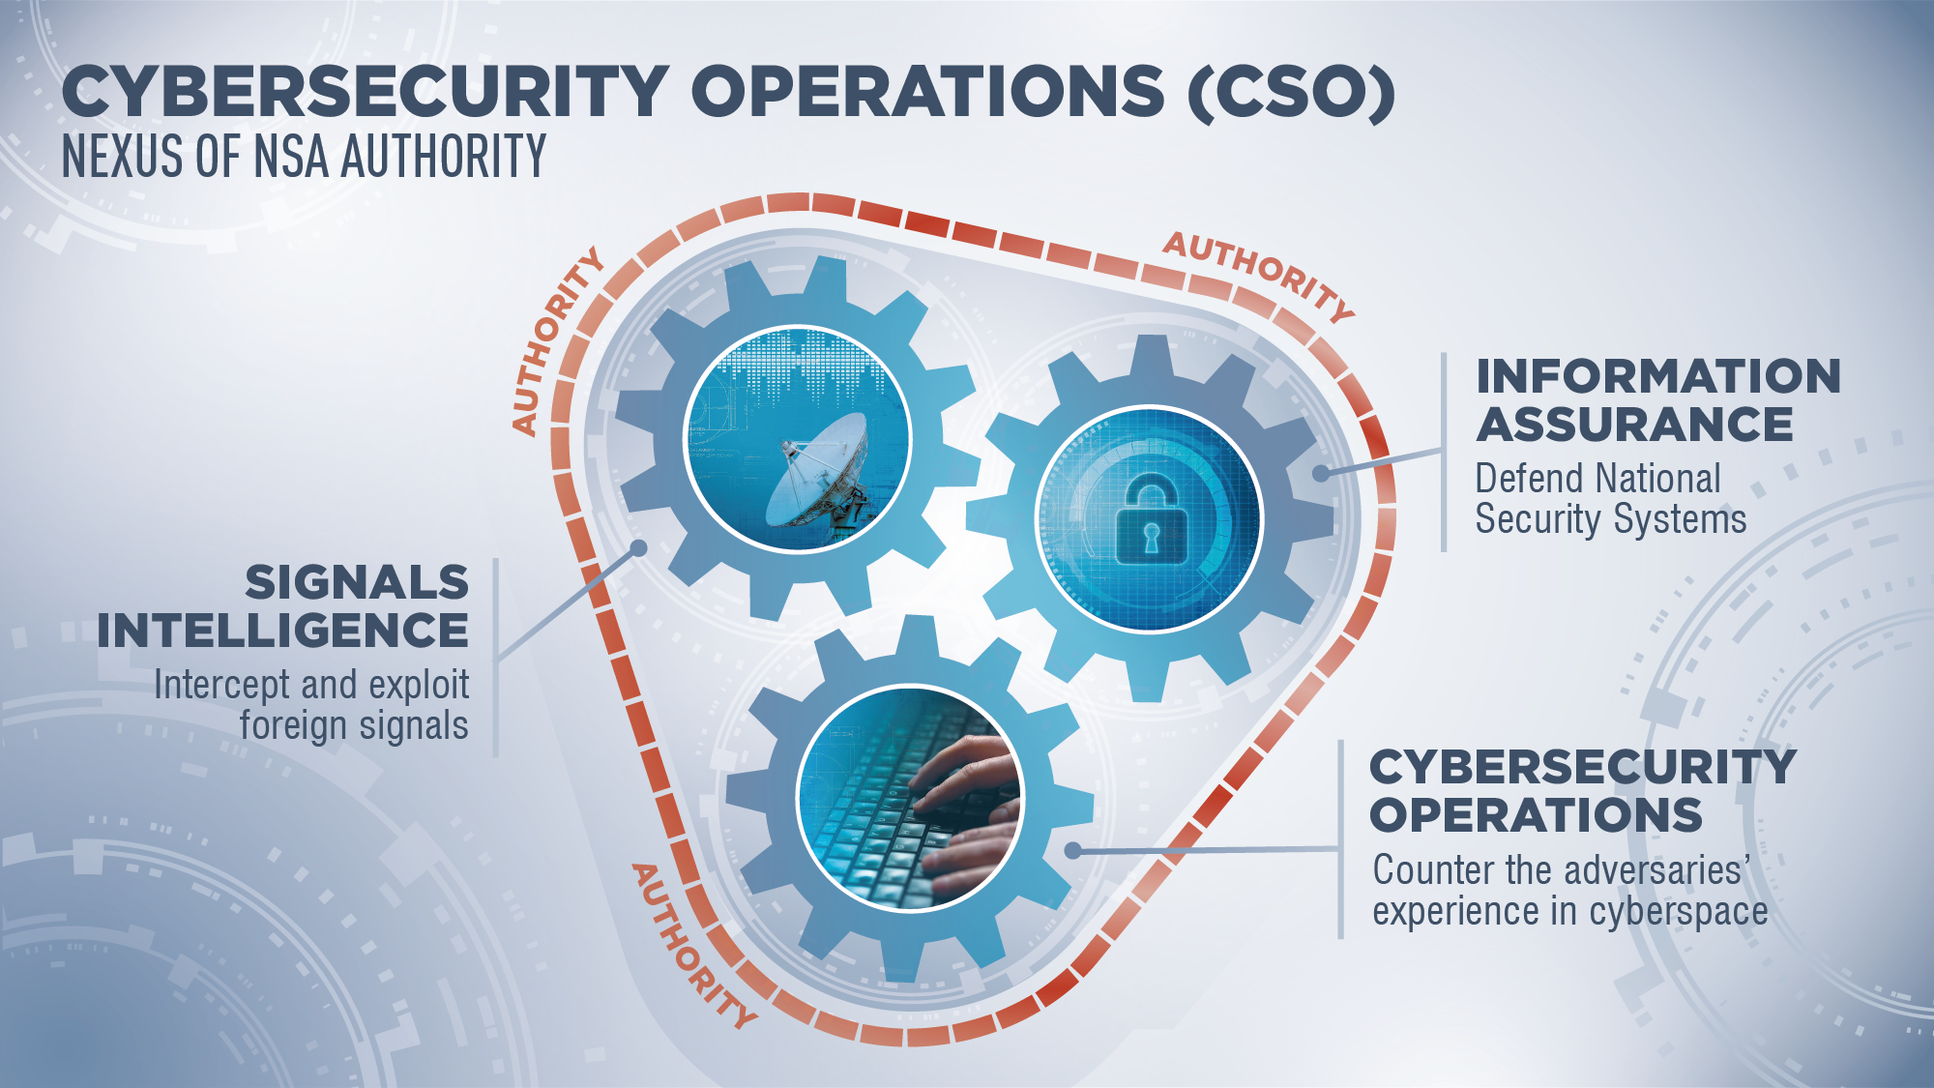

UNCLASSIFIED
UNCLASSIFIED

Slide 6
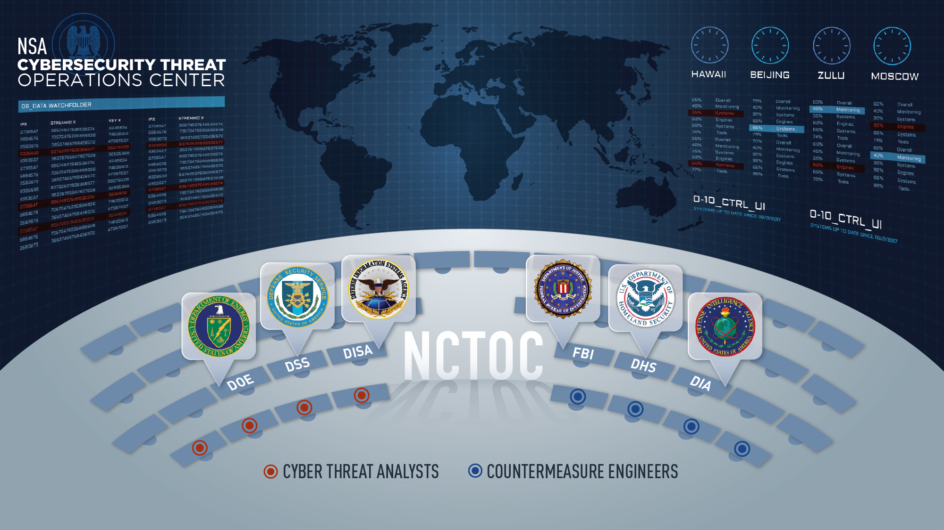








UNCLASSIFIED
UNCLASSIFIED

Slide 7
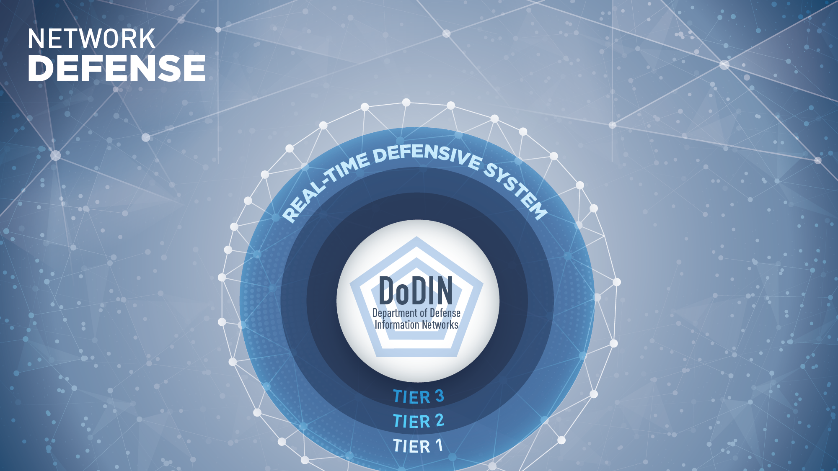



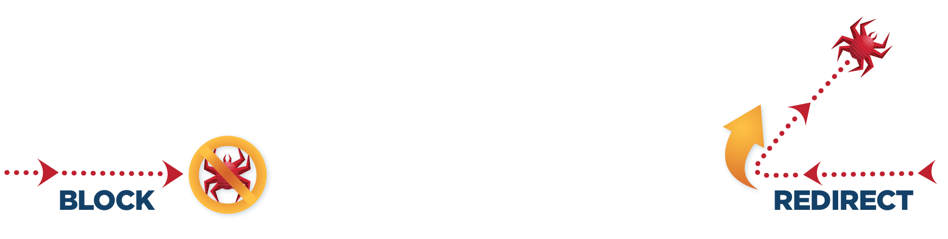

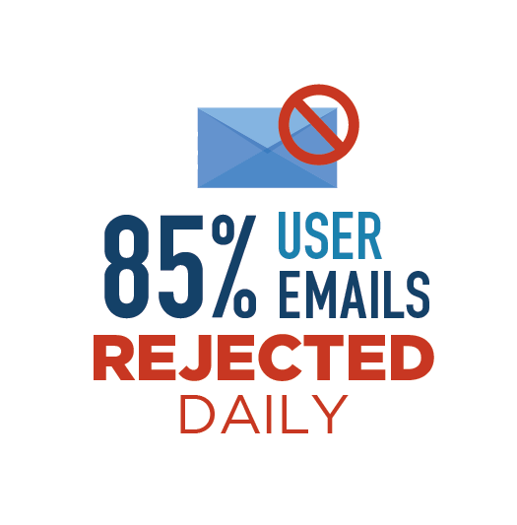
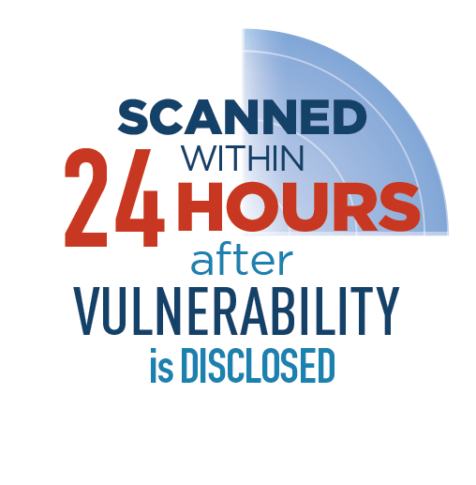
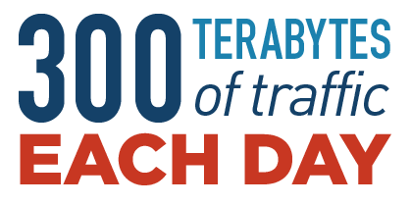
UNCLASSIFIED
UNCLASSIFIED

Slide 8
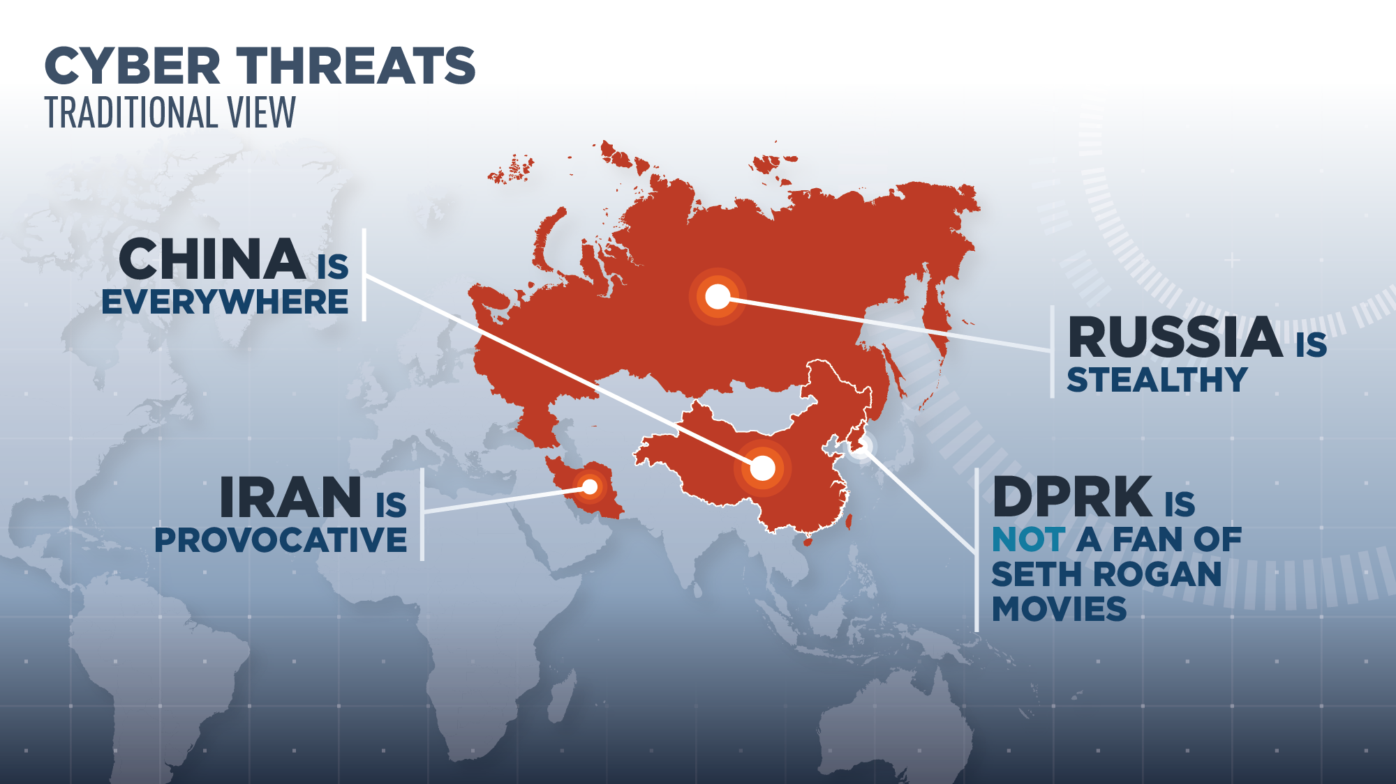
UNCLASSIFIED
UNCLASSIFIED

Slide 9
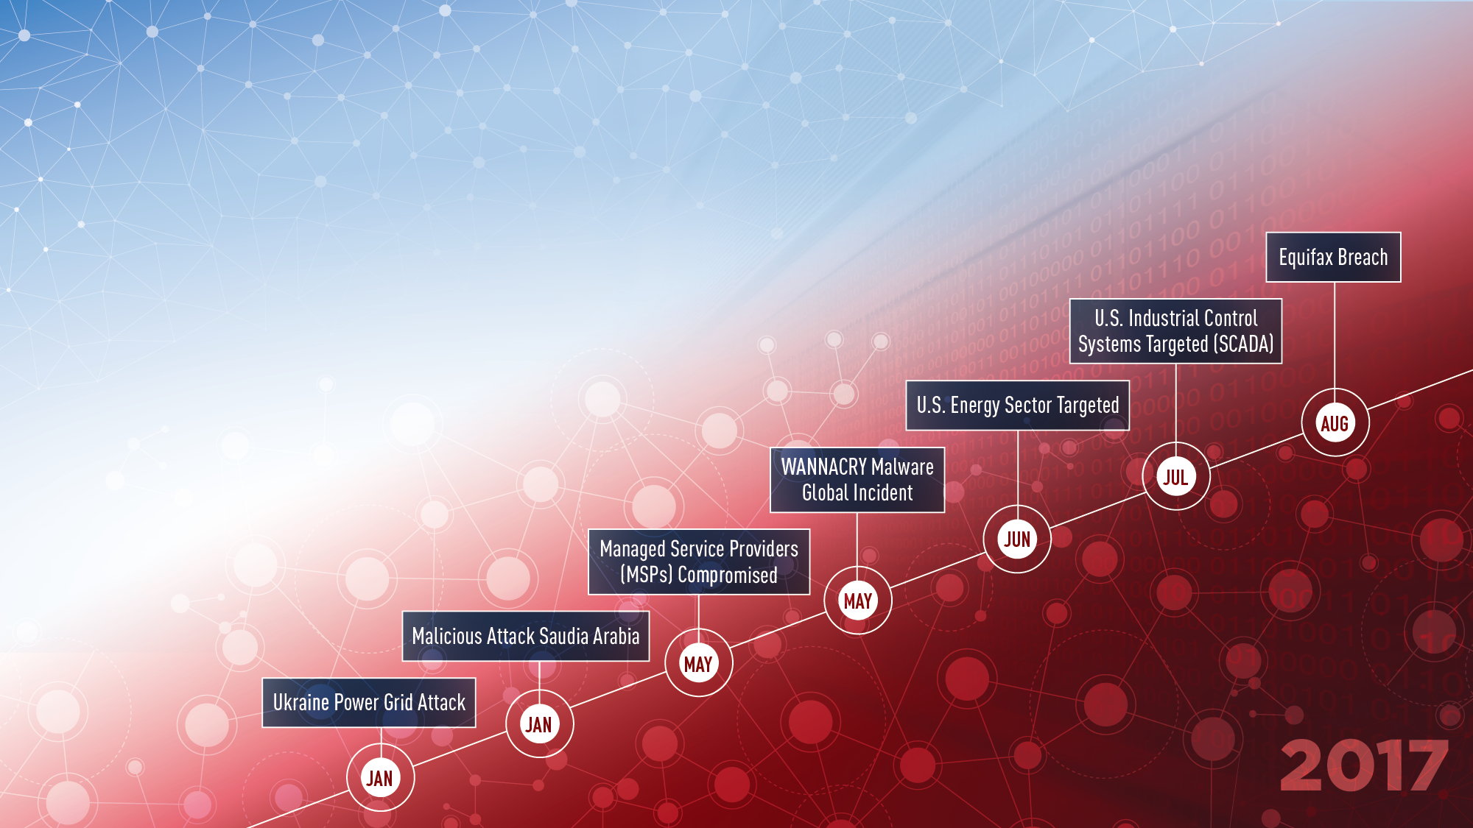


ESCALATING CYBER THREAT
UNCLASSIFIED
Cyber activity continues to become MORE SOPHISTICATED
The LEVEL OF EXPERTISE REQUIRED IS DECREASING
as sophisticated internet tools become easier to use
TREND IS CLEAR: moving from exploitation,
to DISRUPTION
UNCLASSIFIED

Slide 10
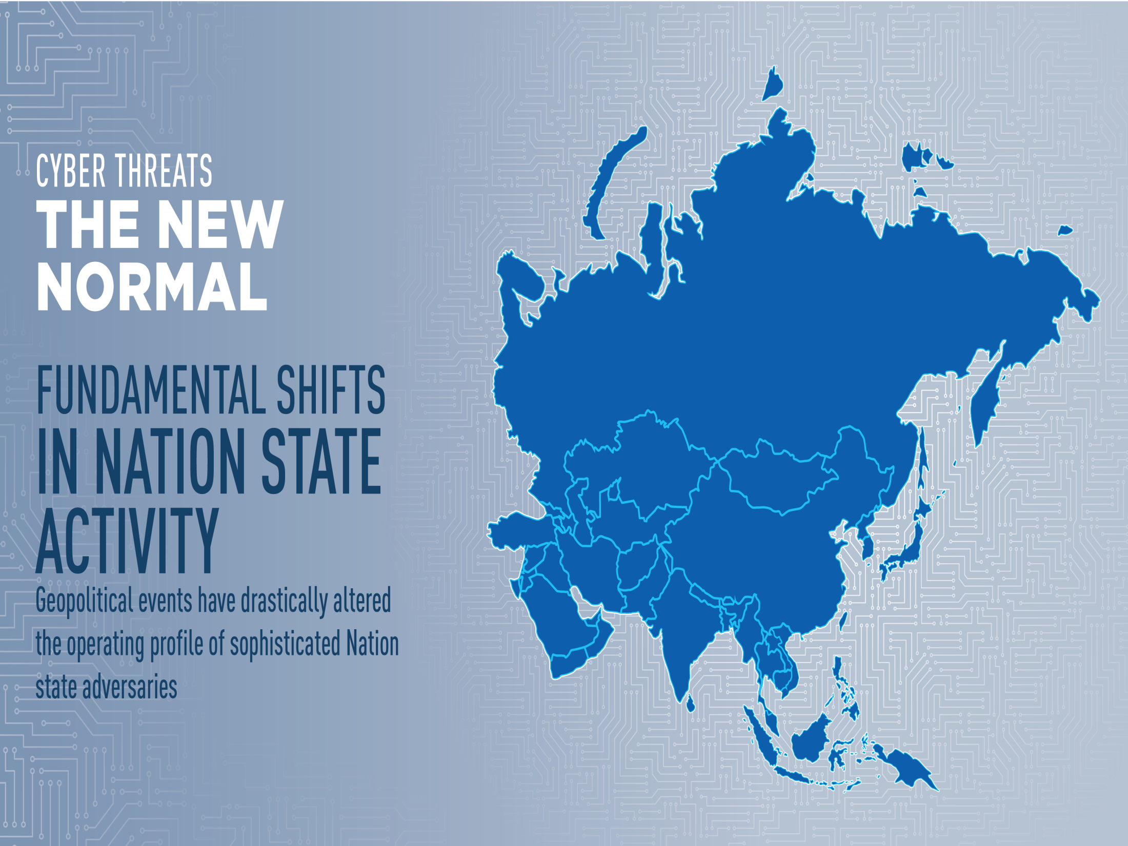
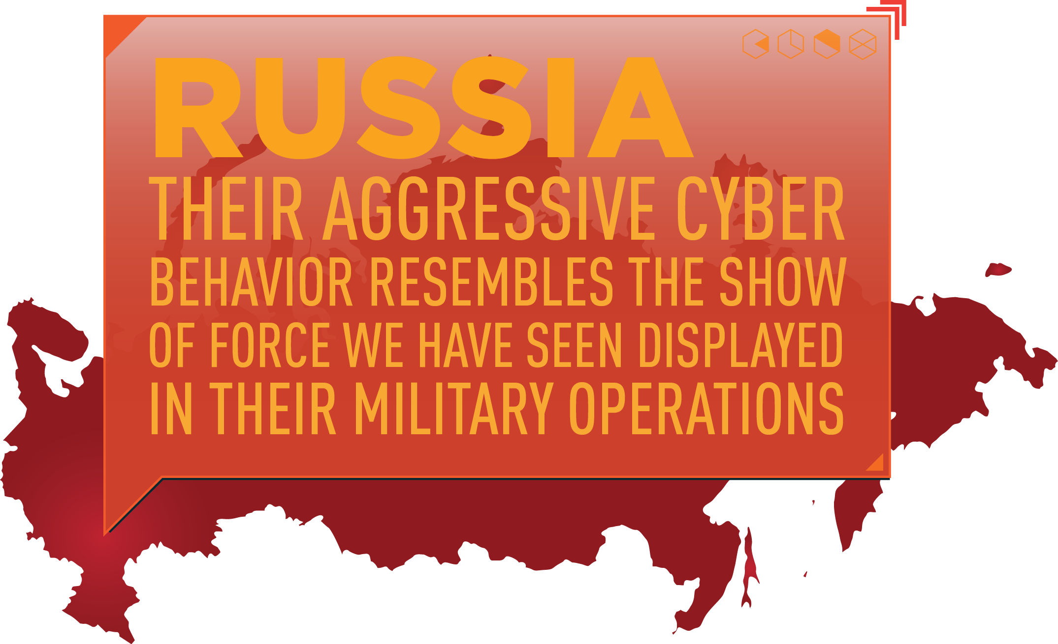
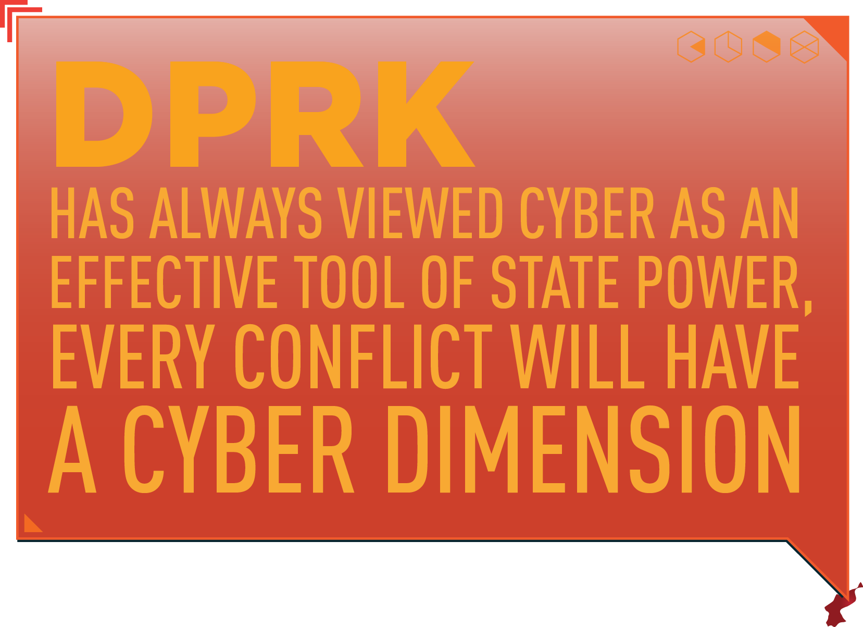
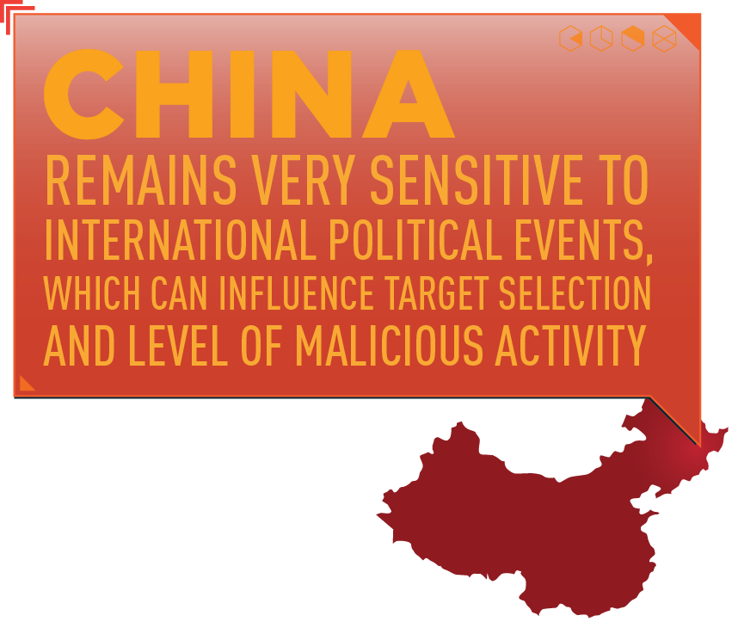
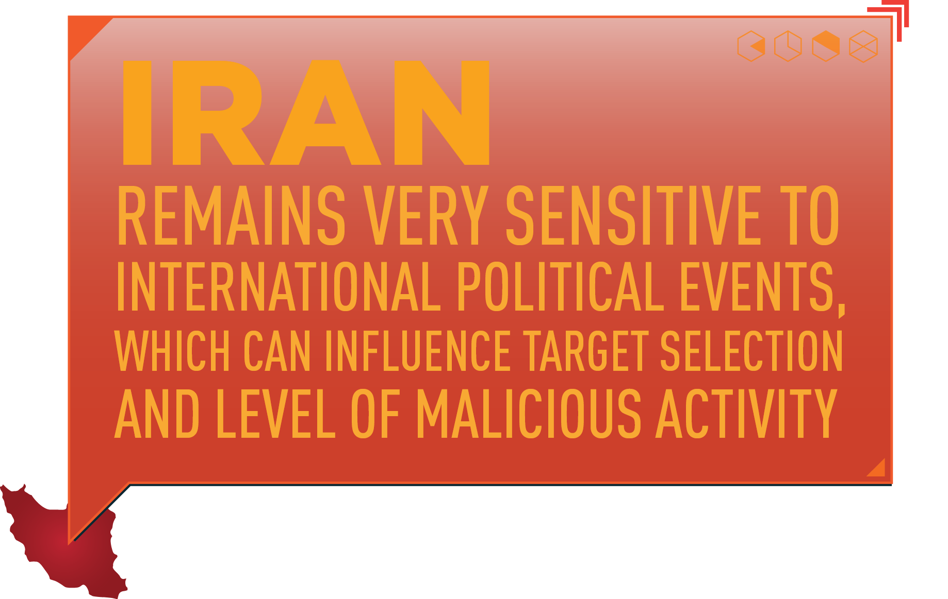
UNCLASSIFIED
UNCLASSIFIED

Slide 11
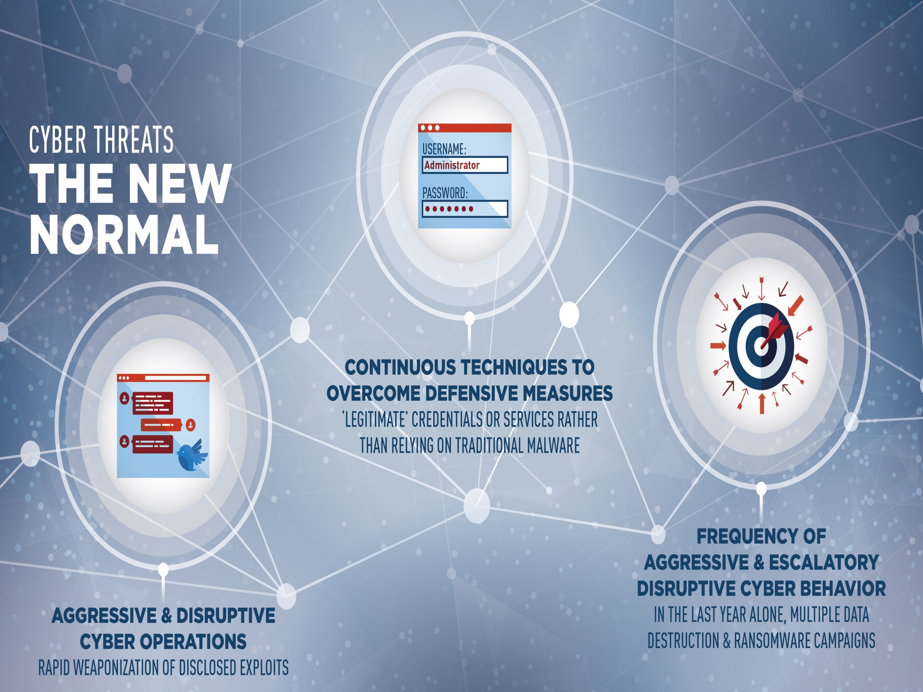
UNCLASSIFIED
UNCLASSIFIED

Slide 12

UNCLASSIFIED
UNCLASSIFIED

Slide 13
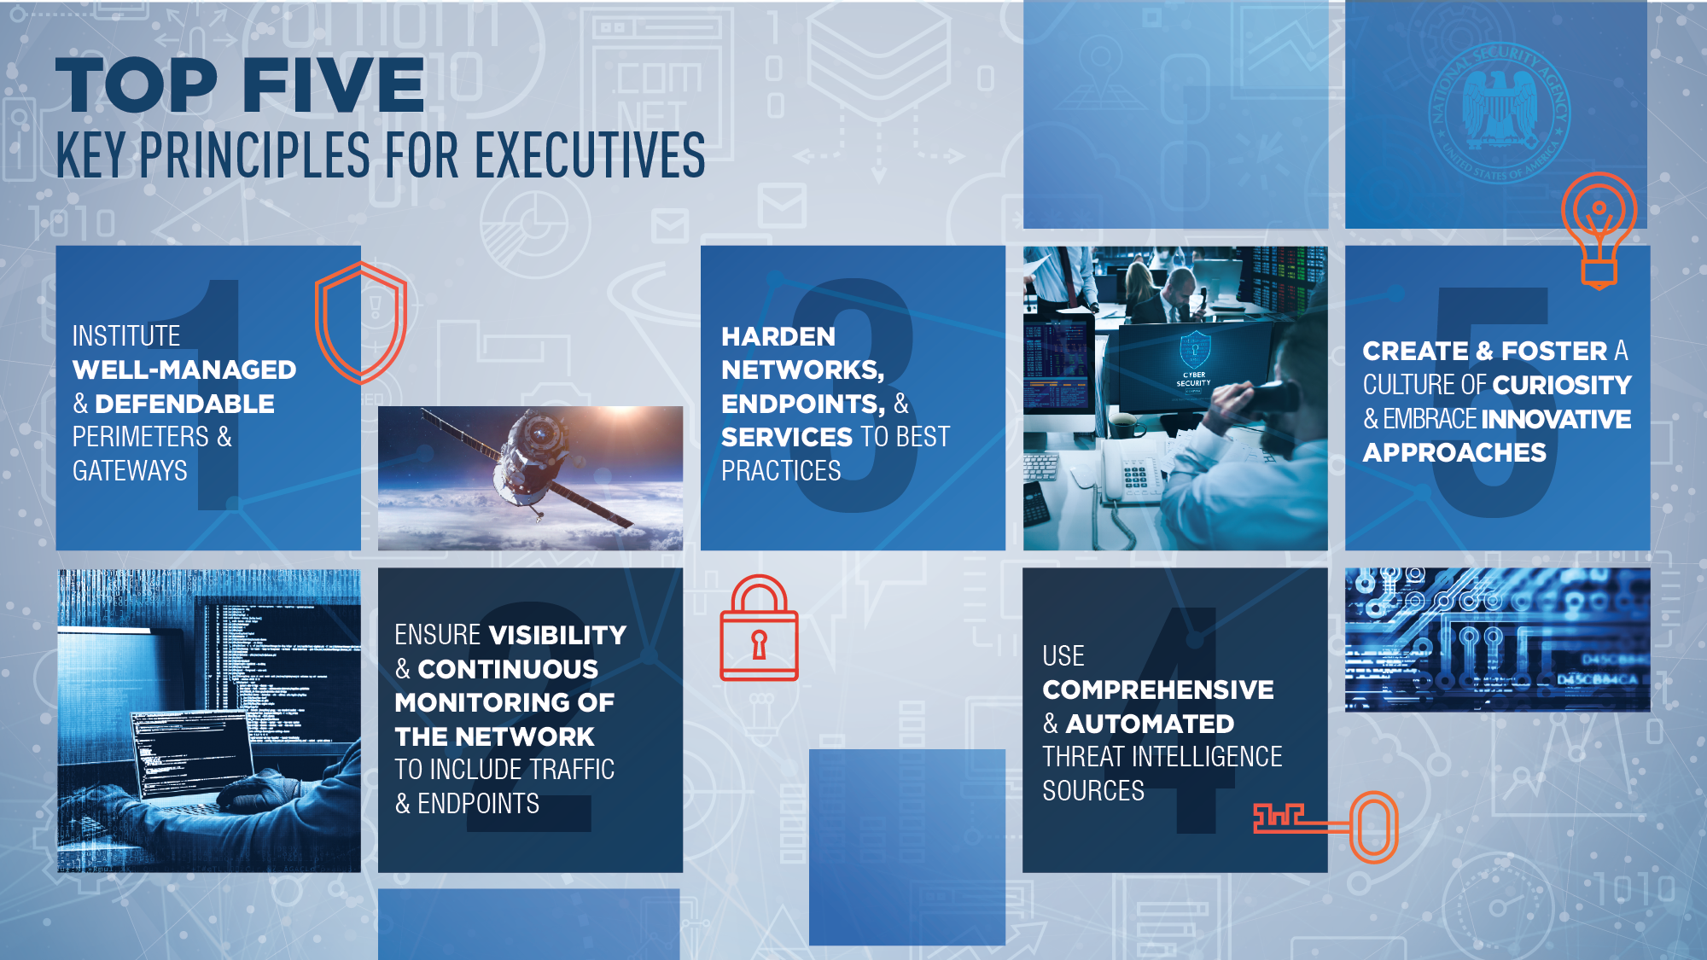
UNCLASSIFIED
UNCLASSIFIED

Slide 14


Slide 15

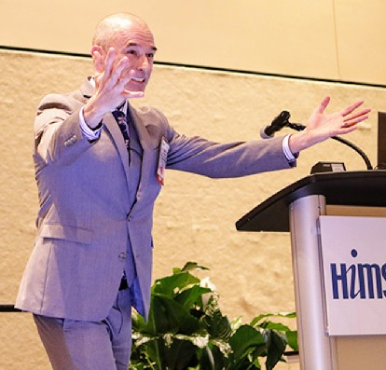
Is Cybersecurity Supposed To Make Sense?
January 10, 2018
Servio Medina
Cybersecurity Policy
Defense Health Agency, HIT (J-6)
Bring the past only if you are
going to build from it
~Doménico Cieri Estrada

Slide 16
Show of Hands
How many of you use Social Media?
  “6 in 10 of you will share this link without reading it, a new, depressing study says” ~Washington Post, June 6, 2016
We are inundated with and often succumb to click-bait, soundbite information.

Slide 17
Impact at Work, In Cyber
Have answers > ability to produce answers
Suffering not only Decision Fatigue, but also “Security Fatigue”*
Is cybersecurity supposed to make sense?
Source: NIST News, ‘Security Fatigue’ Can Cause Computer Users to Feel Hopeless and Act Recklessly, New Study Suggests, Oct 4, 2016

Slide 18
Make Sense?
Federal official: lessen end-user involvement; make IT sophisticated enough to safeguard information and systems.
“94 percent of fatal crashes are caused by human error…top three killers are speed, alcohol and distraction…[even] after significant improvements in safety features built into cars”
~Source: NPR, Unsafe Driving Leads To Jump In Highway Deaths, Study Finds, 2/15/2017

Slide 19
Make Sense?
Medical devices: “If it's got IP, it's IT.”
What about non-networked device/IT? They pose less risk than networked ones…therefore, require less cybersecurity (effort, cost).
Whether medical devices or massive weapons systems, "if it's got a computer in it, it can be cyberattacked…It doesn't matter if it's connected to a network.” ~DoD CIO Richard Hale, 2016

Slide 20
Make Sense?
Paper operating room schedules containing 836 PHI records went missing. $475,000 settlement with HHS OCR.
Made sense to someone = risky behavior

Slide 21
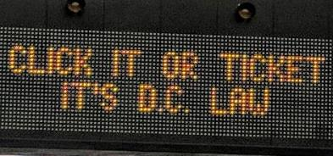
Risky Behavior
Risky Driving
Curb
Risky Behavior
Reckless
Quick/frequent ticket
Texting
Increase risk awareness
W/o Seatbelt
Click it or Ticket
Fatigued
Rumble strips
Your keyboard is like the wheel of your car: both get you where you need to go, but getting behind either comes with risk

Slide 22
But We Mitigate Risk…
Cybersecurity training is required
ANNUALLY
Regular audits
We even keep logs

Slide 23
Effectiveness of Training?
Verizon. Privilege misuse, miscellaneous errors and physical theft and loss represent 80% of breaches within healthcare
Ponemon. Root cause of healthcare organizations’ data breach:
  Criminal attack: 50%
  Third-party snafu: 41%
  Lost or stolen computing device: 39%
  Unintentional employee action: 36%

Slide 24

Effectiveness of Training?
6 months to change a behavior
3 months to change a habit
12 months to change a lifestyle
*Panel Discussion on The Rise of Telebehavioral Health (Related to Alzheimers treatment), HiMSS Connected Health Conference 12/13/16

Slide 25
Two Paths to Better Behavior
Constructive Learning
Environment Optimization
(there’s naturally much more)

Slide 26
Repeated Training versus
Constructive Learning
The role of repetition is in the similarities found when relating new experience to previous experience.
Deep understanding occurs when the presence of new information enables us to rethink our prior ideas.
*Weibell, C. J. (2011). Principles of learning: 7 principles to guide personalized, student-centered learning in the technology-enhanced, blended learning environment. Retrieved July 4, 2011, [https://principlesoflearning.wordpress.com].

Slide 27
FAMILY FEUD
Name a cause of a medical data breach
1) X X X X X X
Human Error 5
Failure to Follow Policy 4
Points derived from informal survey of privacy and security officials
FOSSIL 21
2) X X X X X X
SHELLS 12
3) X X X X X X
Unauthorized Access 3
Theft 2
JARASSIC 13
4) X X X X X X
EONS 5
Mail Handling 1
5) X X X X X X
X
X
X
X
X
X
Total possible
points: 15
“similarities found when relating new experience to previous experience”…”new information enables us to rethink our prior ideas”
0

Slide 28
True or False?
Your healthcare provider washes his/her
hands before they meet/treat you
In 2007, The Johns Hopkins Hospital launched a get-well campaign; hand hygiene compliance increased
  by 2-fold overall after full program implementation
  by 3.8-fold overall in the following 6 months
Source: Infection Control and Hospital Epidemiology, Vol. 33, No. 2 (February 2012), pp. 144-151.

Slide 29
Inadequacy of Audits – People Know
That’s called the Hawthorne Effect

Slide 30
Parallel: Barriers to Compliance
Hopkins: Hand Hygiene
lack of knowledge
poor role models
time/dermatologic problems
skeptical attitudes
poor cleaning station placement
DoD: Cyber Incidents
lack of constant learning
leaders are not engaged
personal convenience > security
denial human error = cause
poor implementation/management
Source: Infection Control and Hospital Epidemiology, Vol. 33, No. 2, Feb 2012
DoD Cybersecurity Culture and Compliance Initiative, Sep 2015

Slide 31
Changing Risky Behavior
Hopkins: Hand Hygiene
Communications Campaign
Education
Environment Optimization
Leadership Engagement
Performance measurement/feedback
“The single biggest problem in communication is the illusion that it has taken place.”
~George Bernard Shaw

Slide 32
Nudge Theory
A nudge is any noncoercive alteration in the context in which people make decisions
  placing fruit at eye level in school cafeterias: enhances its popularity by as much as 25%
  a fly etched into the wells of urinals, giving male patrons something to aim at: spillage was reduced by 80%
Source: The Chronicle Review on Sunstein's Nudge: Improving Decisions About Health, Wealth, and Happiness, May 9, 2008

Slide 33
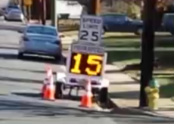
Nudge, Driving Examples
Speed displays: effective in
calling drivers’ attention to their
driving speed.
Grid of lines on the road ahead: evenly spaced at first, begin to bunch closer near the apex of the curve
Source: System Analysis of Automated Speed Enforcement Implementation, April 2016
Source: Chronicle Review on Sunstein's Nudge: Improving Decisions About Health, Wealth, and Happiness, May 2008

Slide 34

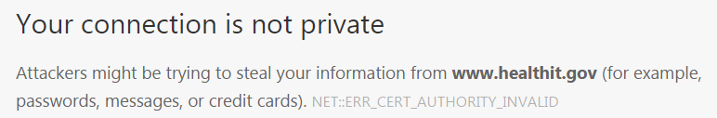
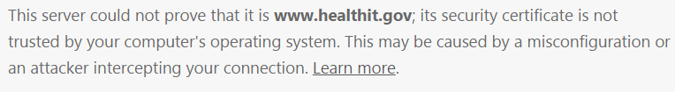
Nudge, Cyber Example 1
Browser habits

Slide 35
Nudge, Cyber Example 2
-----Original Message-----
From: OCR HIPAA Privacy Rule information distribution
Sent: Tuesday, Nov 29, 2016
Subject: [Non-DoD Source] OCR-PRIVACY-LIST Digest
All active links contained in this email were disabled. Please verify the identity of the sender, and confirm the authenticity of all links contained within the message prior to copying and pasting the address to a Web browser.
A phishing email is being circulated on mock HHS Departmental letterhead that prompts recipients to click a link. In the event that you or your organization has a question as to whether it has received an official communication from our agency regarding a HIPAA audit, please contact us via email at OSOCRAudit@hhs.gov <Caution-mailto:OSOCRAudit@hhs.gov>

Slide 36
Nudge, Cyber Examples 3-5
Data Loss Prevention: screen every email for possible loss of PII/PHI?
Outlook Classification Tool: prompt for classification of every email?
Others?

Slide 37
Behavioral/Cultural Changes
Why do you slow down when you see your speed displayed?
Rising rates of change thus compel us not merely to cope with a faster flow, but with more and more situations to which previous personal experience does not apply. -- Alvin Toffler, Future Shock, 1970
Girl Scouts: 18 Cybersecurity badges

Slide 38
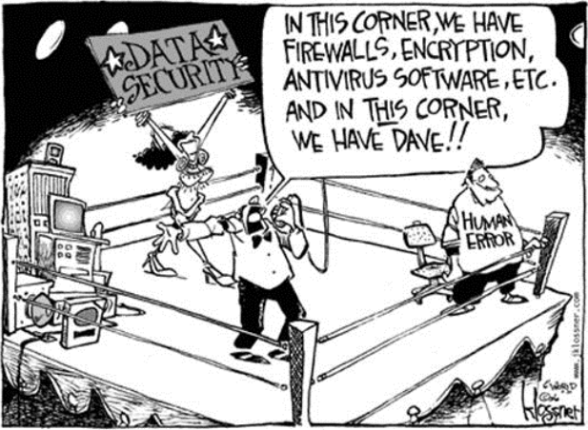
Source: 3D Business Technology People. “Securing the Human Factor”, 3D Corporation, Sept. 14, 2016.

Slide 39
Questions?
Feel free to contact me:
@SecurityServio
linkedin.com/in/servio
servio.f.medina.civ@mail.mil
If you choose not to decide,
you still have made a choice
~Rush,1980
Where people refuse to decide, events will decide for them.
~Charles H. Malik, 1954

Slide 40
References
http://www.beckershospitalreview.com/quality/20-hospitals-with-great-hand-hygiene-programs.html
http://lgreen.net/precede%20apps/HandwashingPRECEDEModelICHE0212.pdf
http://www.washingtonpost.com/wp-dyn/content/article/2008/08/01/AR2008080102591.html
http://www.law.uchicago.edu/news/chronicle-review-sunsteins-nudge
https://www2.idexpertscorp.com/sixth-annual-ponemon-benchmark-study-on-privacy-security-of-healthcare-data-incidents
http://jonahberger.com/books/contagious/
https://ocrportal.hhs.gov/ocr/breach/breach_report.jsf
http://www.idtheftcenter.org/id-theft/data-breaches.html
http://www.privacyrights.org/data-breach
http://www.trendmicro.com/cloud-content/us/pdfs/security-intelligence/white-papers/wp-follow-the-data.pdf
http://www.fiercehealthit.com/story/hospital-cyberdefense-high-dods-priority-list/2016-02-19
https://www2.idexpertscorp.com/blog/single/big-breach-targets-why-healthcare-why-now
http://www.himss.org/News/NewsDetail.aspx?ItemNumber=48552
http://www.hhs.gov/about/news/2016/02/29/hhs-announces-major-commitments-healthcare-industry-make-electronic-health-records-work-better.html
http://www.defense.gov/Portals/1/Documents/pubs/OSD011517-15-RES-Final.pdf
http://www.healthcareitnews.com/news/cybersecurity-special-report-ransomware-will-get-worse-hackers-targeting-whales-medical-devices
https://www.nhtsa.gov/staticfiles/nti/pdf/812257_SystemAnalysisASE.pdf
https://www.nhtsa.gov/Driving-Safety/Aggressive-Driving
https://www.nhtsa.gov/staticfiles/nti/pdf/811996-InvestUseFeasSpeedWarnSys.pdf
https://www.nhtsa.gov/staticfiles/nti/pdf/2011_N_Survey_of_Speeding_Attitudes_and_Behaviors_811865.pdf
https://www.nist.gov/news-events/news/2016/10/security-fatigue-can-cause-computer-users-feel-hopeless-and-act-recklessly
https://www.researchgate.net/publication/268502835_SCENE_A_Structured_Means_for_Creating_and_Evaluating_Behavioral_Nudges_in_a_Cyber_Security_Environment
http://www.nytimes.com/2011/08/21/magazine/do-you-suffer-from-decision-fatigue.html
http://www.npr.org/2017/02/15/515441751/unsafe-driving-leads-to-jump-in-highway-deaths-study-finds
https://www.researchgate.net/publication/268502835_SCENE_A_Structured_Means_for_Creating_and_Evaluating_Behavioral_Nudges_in_a_Cyber_Security_Environment
Weibell, C. J. (2011). Principles of learning: 7 principles to guide personalized, student-centered learning in the technology-enhanced, blended learning environment. Retrieved July 4, 2011 from [https://principlesoflearning.wordpress.com].
Panelist on The Rise of Telebehavioral Health (Related to Alzheimers treatment), HiMSS Connected Health Conference 12/13/16.

Slide 41
BACKUP SLIDES
(can be used if time permits, otherwise, included for reference)

Slide 42
Credit for Nudging Cybersecurity?
SCENE: A Structured Means for Creating and Evaluating Behavioral Nudges in a Cyber Security Environment, Conference Paper, June 2104*
Abstract. Behavior-change interventions are common in some areas of human computer interaction, but rare in the domain of cybersecurity. This paper introduces a structured approach to working with organisations in order to develop such behavioral interventions or ‘nudges’.
I happened upon this while researching. So, yes – the contents of this session are original in a sense, but nudging behavior is certainly not unique or groundbreaking.
*Lynne Coventryª, Pam Briggsª, Debora Jeskeª, Aad van Moorsel^{b}
ª Psychology & Communication Technology Lab, Northumbria University, Newcastle-upon-Tyne, UK
^{b} Head of Computing Science, Newcastle University, Newcastle-upon-Tyne, UK

Slide 43
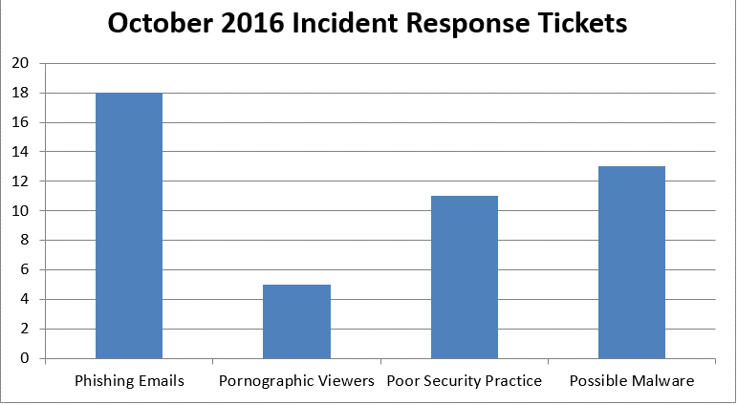
Use Existing Network Reports to
Track User Behavior
How do you track/measure the impact of constructive learning and nudges? Your network tools and SMEs likely track/report similar activity – some of which can be correlated to user behavior. For example…

Slide 44
Use Existing Privacy Reports to Trace
Incidents Back to Human Error
Network with and leverage what other officials are already doing: Privacy, Insider Threat, etc.

Slide 45
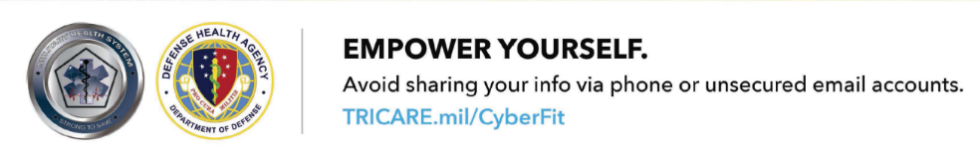

DHA Communications
Put patients at the center of their healthcare ~HHS Sec. Matthews-Burwell and DHA Director VADM Bono (HiMSS 2016)
Military Health System:
9.4M beneficiaries;
205K employees
DHA Cybersecurity and External Communications partnered two years ago to enhance and cybersecurity awareness with beneficiaries. Recall: Communications = one of five primary elements to Johns Hopkins get well strategy

Slide 46


Commonwealth of Virginia Information Security Officer’s Advisory Group
A New Year. New InfoSec Responsibilities,
And Opportunities For Success.
January 2018

Slide 47

Thank You & Happy New Year!

Slide 48

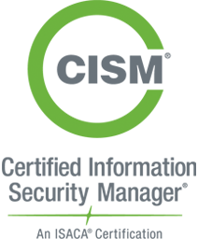

A bit about me: Chuck Ross
GRC Consultant at Impact Makers, in Richmond, Virginia
VCU Master’s Degree
  Information Systems and Services Management
Certified Information Systems Auditor (CISA)
Certified Information Security Manager (CISM)
9+ years in the Information Systems Security & Risk Management Industry
  Information Systems Security Audit
  3rd Party Risk Management
  Information Systems Security
LinkedIn: Chuck Ross’ Profile

Slide 49

The Impact Makers Difference
At Impact Makers, we are redefining business.
Our mission and values are our “Secret Sauce”.
Our passion is doing the right thing to create meaningful change for our clients and our community.
We drive change through our teams of exceptional people, motivated by our mission and guided by our values.
Achieving success is a different experience with us, by design.

Slide 50
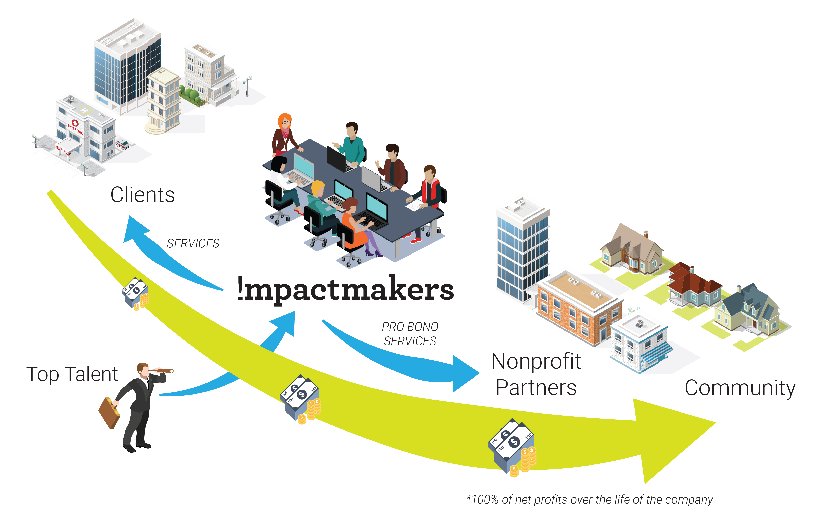
Our Model
100% of net profits, over the life of the company, go to nonprofit partners
To date, that’s more than $2 million in cash & pro bono services
Impact Makers supports 8 community & pro bono partners and is owned by 2 foundations

Slide 51
Agenda
Introductions
Transitioning From 2017 to 2018
2018 Cyber Security Expectations
Recommendations For A More Secure 2018
Q & A

Slide 52


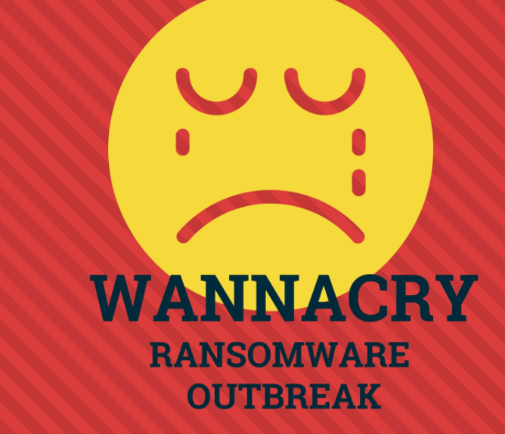
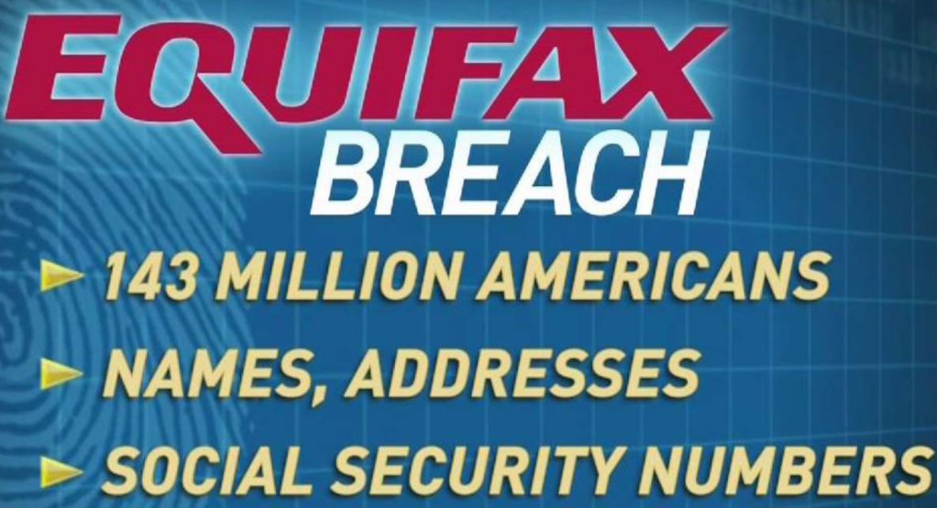


Transitioning From 2017 to 2018:
Notes:
While Hurricane Harvey, Hurricane Maria, and Hurricane Irma brought record-breaking devastation, including significant loss of life, over $200 billion in property damage, personal tragedy and much more, a long string of high-profile data breaches and cyberattacks may actually bring more long-term damage in terms of economic impact and loss of trust in our digital economy and way of life in America.
From Equifax to Uber, the top data breaches of 2017 brought personal financial impact to every American with a bank account, mortgage, credit card or other credit history.

Slide 53
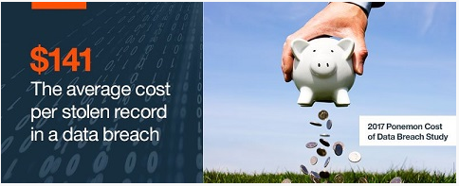
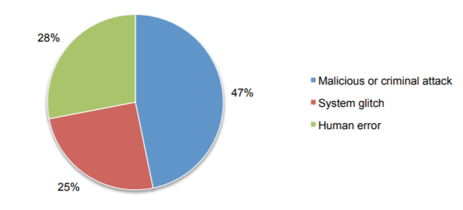
2017 Avg. Data Breach Costs And Top Trends
2017 Average Number Of Records Stolen Per Breach:
  24K Global
  28K US
  Increase Of 1.8% From 2016
Average Global Cost Per Cybersecurity Incident: $89,000
  Significantly less when Incident Response and Threat Management Programs are in place & actively trained on (Microsoft 2017 Incident Response Guide)
Average Global Cost Per Data Breach: $3.62 Million; Public Sector Breach: $1.98 Million
Worldwide, 47% Of All Data Breaches Were Due To Malicious Or Criminal Attacks (52% Within The United States)
(Source: 2017 Ponemon Institute Cost of a Data Breach Study)
Notes:
12th annual “Cost of Data Breach Study,” the industry’s gold-standard benchmark research, independently conducted by the Ponemon Institute.
The average global cost of data breach per lost or stolen record was $141. However, health care organizations had an average cost of $380 and in financial services the average cost was $245. Media ($119), research ($101) and public sector ($71) had the lowest average cost per lost or stolen record.
The average size of a data breach (number of records lost or stolen) increased 1.8 percent over last year. The average number of breached records by country or region Global average = 24,000 US: 28,500
$3.62 million is the average total cost of data breach.

Slide 54
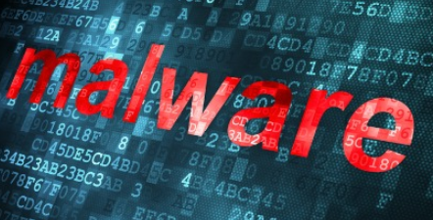

2017 Industry Incident and Breach Threat Vectors: Public Sector
Malware Exploits
  Email based delivery most common
  Crimeware (ransomware specifically) increasing dramatically
  Spyware (i.e. state secrets) also prevalent
Insider Threats
  Internal Privilege Misuse – typically financially driven (identity theft)
  Miscellaneous Errors - often is misdelivery of data sets, publishing errors, and disposal errors
Lagging Patching Cadences
  Deployments occurring in months and quarters, instead of days and weeks
Struggling Endpoint Security
  Due to increasing environment complexity (i.e. BYOD, IoT)
  Aging software sets due to infrastructure challenges
Social Tactics (i.e. Social Engineering, And Phishing)
  Primarily due to insufficient cyber security education training campaigns
Timeline for breach to discovery is over 50% in the “years” category.
(Sources: Verizon 2017 Data Breach Investigations Report and SecurityScorecard’s 2017 Government Cybersecurity Report)
Notes:
Internal Privilege Misuse -most common is the average end-user absconding with data in the hope of converting it to cash somewhere down
the line (60%). Personal information and medical records (71%) are targeted for financial crimes, such as identity theft or tax-return fraud.

Slide 55


2017 Industry Incident and Breach Threat Vectors : Healthcare
Malware Exploits
  Crimeware (ransomware specifically) increasing dramatically -accounts for 72% of malware incidents.
  Email based delivery also still prevalent
Insider Threats
  Miscellaneous Errors - misdelivery, disposal errors, and physical theft and lost assets combine for almost 30% of all healthcare breaches
  Internal Privilege Misuse – typically financially driven (identity and medical history theft)
Endpoint Security Due To Increasing Complexity
  Supply Chain Management issues relating to medical devices not being appropriately secured and configured
Timeline for breach to discovery is 63% between the “minutes” and “weeks” category.
(Sources: Verizon 2017 Data Breach Investigations Report)
Notes:
Internal Privilege Misuse -most common is the average end-user absconding with data in the hope of converting it to cash somewhere down
the line (60%). Personal information and medical records (71%) are targeted for financial crimes, such as identity theft or tax-return fraud.

Slide 56
2018 Cyber Security Expectations And
Recommendations For A More Secure 2018
Notes:
The good news is that Security is going to continue to provide an interesting and challenging career for the New Year! The bad news….

Slide 57


2018 Cyber Security Expectations and Trends
There are so many possibilities…Just to name a few:
Ransomware will continue to proliferate, at an even more explosive pace
  The threat may even evolve into Ransomware-as-a-Service (RaaS) due to significant criminal financial gains in 2016 – 2017.
Cybersecurity skills and hiring gap will continue to dramatically expand
The IoT world will continue to grow, and be just as painful to manage
  Due to a lacking security framework to hold third parties accountable
  Attacks will be both targeted at financial gain and service disruptions
Cloud environments will become a target for compromise due to interconnected nature, and ‘breach economies of scale’
Incident response will become more automated to keep pace with attacks
(Sources: CSO Online, Security Magazine.com)
Notes:
Cybersecurity Ventures predicts that organizations globally will suffer a ransomware attack every 14 seconds by 2019.
Global ransomware damage costs are predicted to exceed $11.5 billion by 2019, up from $5 billion in 2017” which is a 15 times increase from $325 million just two years ago. In addition, they predicted that ransomware attacks on healthcare organizations will quadruple by 2020. "
Cybersecurity Ventures predicts there will 3.5 million unfilled cybersecurity jobs by 2021, up from 1 million openings in 2014.

Slide 58
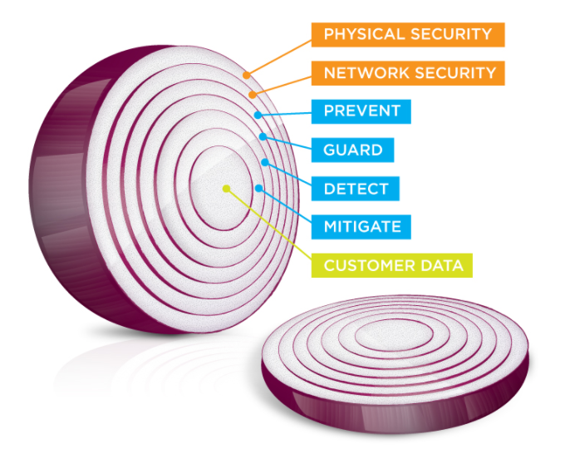
Recommendations For A More Secure 2018
Implement and maintain a robust malware defense strategy
  Retool email gateways to block executables, macro-enabled office extensions (i.e. docx, xlsx), .js, etc.)
  Only allow executables on a “by exception” basis
  Keep client and browser based email software fully patched
  Implement whitelisting where possible
  Implement network monitoring and prevention tools to detect and stop malware before insertion
Continue to train employees on appropriate technology use, as well as existing and emerging security threats
  Use varied training methodologies to improve Awareness Training buy in and retention
  Leverage incident metrics to identify repeat offenders and pursue in accordance with policy
Develop a sound system and data backup strategy to match established RPO’s and RTO’s
Improve SDLC’s for homegrown systems to bake security in at all stages of development
  Develop controls to require that security is involved in SDLC stop gates before PROD releases
Notes:
According to Ponemon’s 2017 Cost of a Data Breach Study: Implementing employee security awareness training was quantified at reducing the cost of a data breach by $12 per record. Other sources site this as the most effective ROI Security Investment.

Slide 59

Develop and Implement Robust Monitoring & Incident Response Controls
“But what is worrying is that most sectors are falling into a familiar trap: by focusing so much on defense, it has failed to make provisions for an effective recovery.”
James Henry, Auriga Security Consulting Practice Manager
It is important to recognize that some cyber attacks will succeed. Having a strategy in place that allows the organization to rally and recover is therefore just as important as defensive resilience.
Notes:
Transitioning away from Preventative Controls…Talking about castle concept… Extremely focused on ensuring that no-one gets in. Most orgs are spending their money on prevention (like a castle.. the hill .. .the moat… the high walls…) but when it comes to detection (vigilance) and response (resilience)… budgets are exceeded and spent so it’s not a balanced investment on protective, detective, and corrective controls. The result of this is that most organizations do not have effective monitoring or incident response controls in place when “the event” occurs.

Slide 60
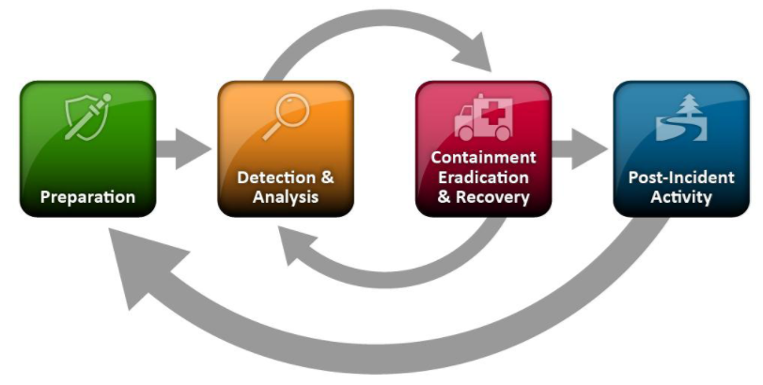
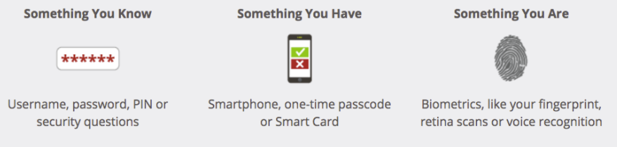
Recommendations For A More Secure 2018 (cont’d)
Implement a robust incident response program
  Develop documented IR Plan
  Assign responsibilities to establish IR team(s)
  Test IR Plan with varied scenarios on a regular basis
  Automate as much as possible (i.e. SIEM, IDS/IPS, etc.)
Develop a robust third party provider management program
  Integrate security into all purchasing and contracting processes
  Review all third parties on a ongoing basis against established security requirements
Improve/decrease endpoint patching cadence cycles where possible
Classify sensitive datasets, and encrypt extensively (at rest and in transit)
Implement two-factor or multi-factor solutions to improve access controls for end users and administrators for all systems
Notes:
According to Ponemon’s 2017 Cost of a Data Breach Study: Implementing a full scale IR Program would reduce the cost of a data breach by as much as $19 per record. (in comparison to the Avg. cost of $141 per record).
According to Ponemon’s 2017 Cost of a Data Breach Study: Implementing Extensive encryption would reduce the cost of a data breach by up $16 per record.

Slide 61
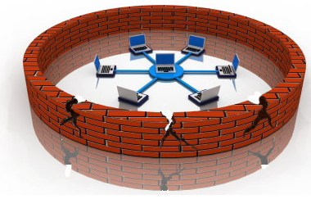


Learn To Know What You Don’t Know….
Malicious actors will not stop in their attempts to steal your data.
Attack methods are changing over time.
Proactively learn where IT & Security weaknesses are.
Outside parties are essential in helping you learn what you don’t know (Gap Analysis) so you can proactively improve the Security Posture:
    Penetration Testing of Network & Applications
    Threat Testing of Network & Applications
    Vulnerability Testing of Network & Applications
    Risk and Security Maturity Assessments
    IT & Security Audits
Notes:
Speak to data driven assessments and using tactical exercises to drive future strategy for security spend and control implementation.

Slide 62



Slide 63
rdecker@impactmakers.org
Commonwealth of Virginia Information Security Officer’s Advisory Group
A New Year. New InfoSec Responsibilities,
And Opportunities For Success.
January 2018

Slide 64
Impact Makers’ Detailed GRC Capabilities
Assessments
Information Security Program Maturity
IT System Risk Assessment
HIPAA Risk Assessment
IT Governance
Fractional CISO Services
Information Security Policy and Procedures
Security Architecture
Information Security Program Development
Information Security Governance Structure
Information/Data Governance
IT Risk Management
Data Classification
Incident Response Planning
Data Breach Remediation
Continuity Planning
Disaster Recovery Planning
Response Planning
Compliance
HIPAA and Omnibus Rule Security
Commonwealth of Virginia Information Security (SEC501)
NIST Cyber Security Framework
Execution
Information Security Maturity Model
Risk Assessment
Policies & Procedures
IS Program Implementation
IS Governance Council
Incident Playbook
Business Impact Analysis
Continuity Plan
Disaster Recovery Planning
IS Strategy
IS Transformation
GRC Project Management
GRC Process and Change Management

Slide 65

Business Transformation
GROWTH | REDUCTION | COMBINATION | SEPARATION | TRANSFORMATION | OPTIMIZATION
Technology Consulting
TECHNOLOGY STRATEGY | CIO SERVICES | APPLICATION SERVICES | INFRASTRUCTURE SERVICES
People & Change
CM FRAMEWORKS | TRANSFORMATION ASSURANCE | SCALE | MAGNITUDE | DURATION | IMPORTANCE
Security & Compliance
SECURITY STRATEGY | SECURITY ROADMAP | RISK MANAGEMENT | GOVERNANCE FRAMEWORK | REGULATORY COMPLIANCE
Mission Aligned Teams
DRIVING CHANGE THROUGH MOTIVATION
Digital & Customer Experience
WEBSITE DESIGN | CMS IMPLEMENTATION | MARKETING | STRATEGY | SOFTWARE SELECTION | RESEARCH | EXPERIENCE DESIGN
Data & Analytics
Value-based
CREATING MEANINGFUL CHANGE
AWS | TABLEAU | HANA | GAMIFICATION | DATA ENRICHMENT | COGNOS FRAMEWORK MANAGER
Project Management
Community Focused
REDEFINING BUSINESS
SUSTAINABILITY & PRODUCTIVITY | AGILE ENTERPRISE | PERFORMANCE TRANSFORMATION | STRATEGY AND OPERATIONAL EXCELLENCE
Business Results
BUSINESS OPTIMIZATION | SUSTAINABLE CHANGE | COMPETITIVE ADVANTAGE | REDUCED RISKS | INCREASED MARGINS | ENGAGED CUSTOMERS

Slide 66
Upcoming Events
www.vita.virginia.gov
66

Slide 67
Future ISOAG
February 7, 2018 @ CESC 1:00-4:00
Speakers: Kevin Heaslip, PH.D.,PE VA Tech
Kathy Bortle & Dean Johnson, VITA
Bill Freda, VITA
ISOAG meets the 1st Wednesday of each month in 2018

Slide 68
Registration is Now Open
“2018 COVA Information Security Conference: “Expanding Security Knowledge"
April 12 & 13
Location: Altria Theater
https://wm.irisregistration.com/Site/VITA2018
Registration Fee - $175
*Contact CommonwealthSecurity@vita.virginia.gov for more information

Slide 69
Conference Keynote Speakers
Adam S. Lee,
Special Agent in Charge
Federal Bureau Investigations (FBI) Richmond (Division) Field Office
Dr. Deanna D. Caputo
Principal Behavioral Psychologist
Human Behavior and Cybersecurity Capability Steward
The MITRE Corporation

Slide 70

ADJOURN
THANK YOU FOR ATTENDING
Picture courtesy of www.v3.co.uk

