Slide 1
Artificial Intelligence (AI)
Unpacking EO 30 Policy & Standard

Slide 2
We want to use ai
Predict, Response & Repair
Human Augmented
Autonomous
Perception
Conversational
Text & Sentiment Analysis
Document Processing & Insights
Translation
Bias, Defect & Anomaly Detection
Search
Generative

Slide 3
AI Policy & standards
Utilization of AI by COV Policy Standard | Enterprise Architecture AI Standard
Ethical Use — AI solutions must be resilient, accountable, and explainable; AI models must be documented; AI outcomes must be validated for bias Business Cases — AI must be the optimal choice for a stated result and produce positive outcomes for COV citizens Mandatory Approval — each use of an AI solution must be recorded in an AI central registry and reviewed for approval by VITA and the secretariat Mandatory Disclaimers — public disclosure when AI is used to produce any decision or output, including how decisions were produced Risk Mitigation — AI vendor health assessment as part of procurement Protect Citizen Data — notification and required consent when using citizen data, and the security of sensitive and protected information | Safety — AI systems must be employed in such a way that they cause no harm to people, businesses, or the environment Privacy — data collected, leveraged, or trained in an AI System must be untraceable back to an individual Transparency — use of AI solutions in COV systems must be clear as to their use, extent, and value Accountability — risks associated with COV decisions must always remain with humans to avoid potential bias and discrimination by AI systems Sustainability — building and fostering skills that will support COV into the future and not lead to automation complacency or de-skilling

Slide 4
AI Registry overview
Registration
Approval
Recertification
Agency review/approval by ISO, AITR & AH
Final review & approval by responsible Secretary or designee
Agency provides data: purpose, technology used, sensitivity, model algorithm, data sets used, & operation method
Annually, for continued use (ISO via Archer)
VITA/CIO review & recommendation

Slide 5
AI Registration & approval workflow
Agency creates entry in AI Registry (Archer)
Agency ISO & AITR Approvals (Archer & CTP)
Submit to VITA (CTP)
VITA Review (CTP)
Commonwealth CIO Recommendation (CTP)
Submit to requesting Agency’s Secretary (email)
Secretary Review & Approval (email)
Notification sent to Agency & VITA (CTP)
Agency
VITA
Secretary

Slide 6
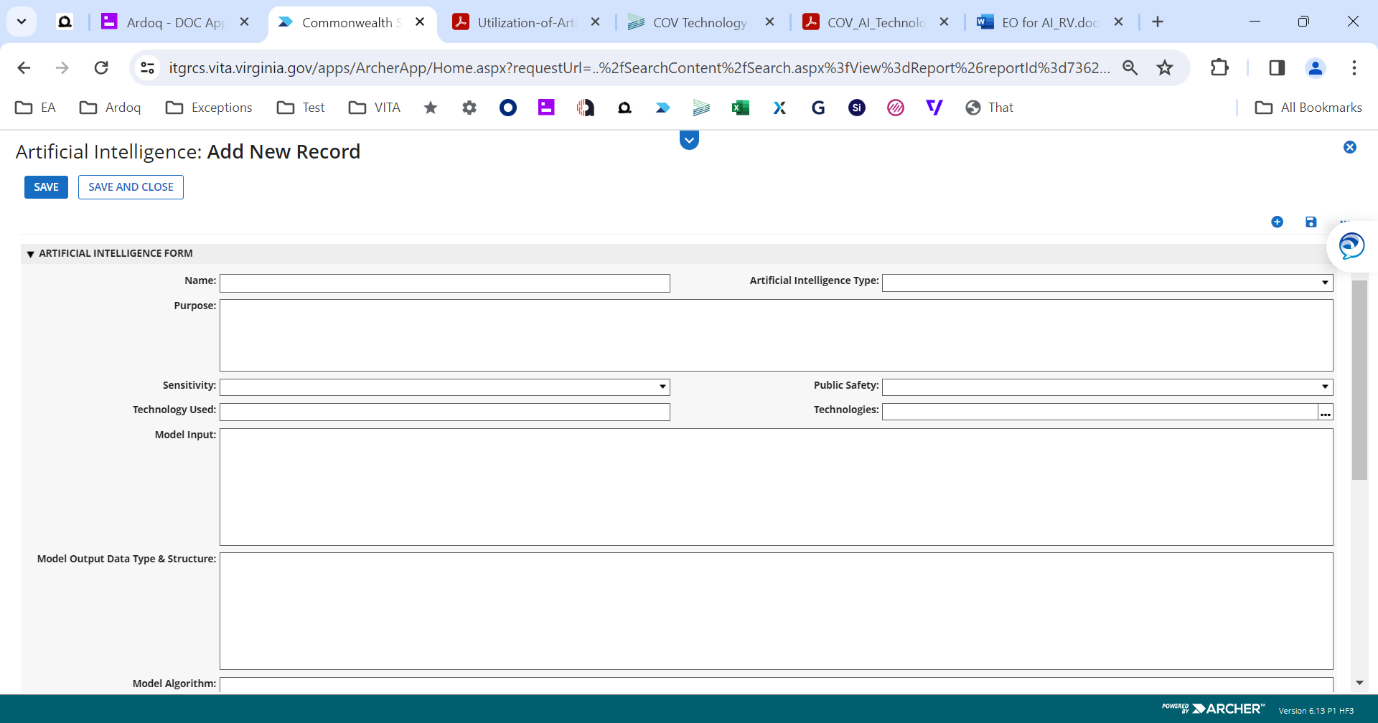
AI Registry walkthrough — Use case, technology & risks - Archer

Slide 7
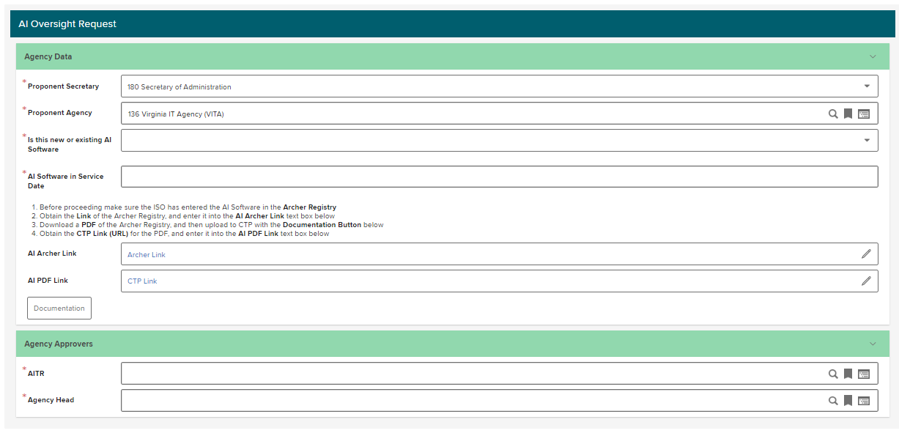
AI Registry walkthrough - application to obtain approvals - CTP

Slide 8
AI Technology roadmap
Align business strategy with technology strategy
Improve time-to-value by identifying AI technologies that have been vetted and approved for use
Inform technology choices through classification of AI solutions by capability
Support registration and approval of new AI instances
Communicate COV AI selections to the general public (including localities)

Slide 9
Resources
VITA webpage on AI: https://www.vita.virginia.gov/artificial-intelligence/
We are here to help, and we welcome the opportunity to work with you! Contact your assigned EA architect or ITIMD analyst for questions and assistance!
https://www.vita.virginia.gov/technology-services/cams-other-contacts/
Thank you!

